Slide 1
BRAIN FLIGHT: DETERMINANTS INFLUENCING THE EXODUS OF HEALTHCARE PROFESSIONALS IN NEW ZEALAND BY: DERRICK BOADU ASANTE

Slide 2
Presentation Outline
Introduction
Research Objectives & Method
Determinants of Brain flight
Summary of key findings
Recommendations
Similarities of the Topic to The Ghanaian setting
Recommendations for Ghana
Conclusion

Slide 3
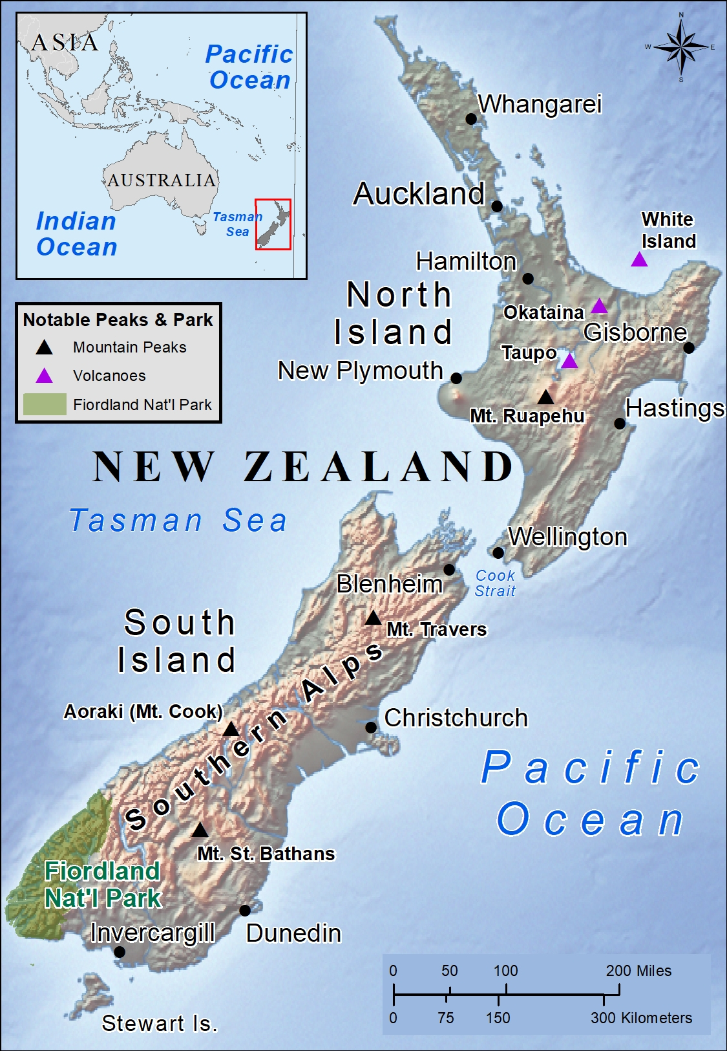
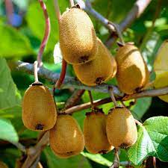



New Zealand/Aotearoa

Slide 4
New Zealand/Aotearoa
Has two main landmasses. ie. North Island and South Island. Known for its beautiful landscape and over 600 smaller Islands.
Population of 5.3 million people, 17% are youth.
Gross domestic product :252.2 billion USD (2023).
Highly developed free-market economy, nominal GDP NZD $425 (2024). OECD Member.

Slide 5
Introduction
New Zealand faces a significant exodus of healthcare professionals to neighboring countries like Australia.
Brain flight : Migration of highly skilled workers from their home countries for better opportunities and quality of life .
This term emerged in the 1950s – 60s when British scientists migrated to the U.S. seeking for improved work conditions

Slide 6
Introduction
It has significantly impacted developing regions like Africa, Asia and the Caribbeans. Historical roots can be traced to the transatlantic slave trade .
Determinants: are the driving factors behind migration.
Exodus: emigration of people from a particular place

Slide 7
Research Objective & Method
Objective: Identify causes of health professional emigration from NZ.
Method: Qualitative document analysis of official reports , policies and literature.
Desk review :existing documents and data were collected, reviewed, and analyzed.
Focus on push and pull factors influencing migration.
Push Factors : Low salaries, complex licensing, poor career paths.
Pull Factors: Better wages, faster licensing, Political stability.

Slide 8
Key Determinants of Brain Flight
Wage Differentials
Salaries in New Zealand are up to 30% lower compared to Australia.

Slide 9
Wage Comparison: NZ vs Australia

Slide 10
Key Determinants of Brain Flight
Low Life Expectancy
Lower than Australia, Japan, Switzerland, South Korea, Norway and many other OECD countries.

Slide 11
Life Expectancy Comparison: NZ, Australia and Japan
Country | 2022 (years) | 2023 (years) | 2024 (years)
New Zealand | 81.96 | 83.00 | 82.95
Australia | 83.20 | 83.05 | 84.06
Japan | 84.91 | 85.03 | 85.15

Slide 12
Key Determinants of Brain Flight
Dominance of International Healthcare Graduates :many of whom return home after training.
59% of qualified healthcare professionals in New Zealand are international medical graduates (IMGs) , statistics NZ

Slide 13
Key Determinants of Brain Flight
Licensing Delays: The licensing requirement for health professionals in New Zealand is difficult and cumbersome.
Limited Career Pathways for healthcare professionals, particularly nurses and doctors.
Flexible emigration policy with easy visa acquisition and other procedures makes it easier to move out of New Zealand, especially to Australia. Ie. Trans-Tasman Mutual Recognition Arrangement

Slide 14
Emigration Data
Health Professional Category | Approx. Emigration Rate | Dominant Destination
NZ-registered nurses in Australia (2023) | 23,802 registrations | Australia
NZ nurses registering for Australia (2023–24) | 11,989 | Australia
NZ‑born doctors | 29% working abroad | Australia , UK

Slide 15
Healthcare Workforce Shortage (2023)
Shortage of over 4,800 nurses and 1,700 doctors. By 2032, the shortage is predicted to quadruple.
29% of NZ-trained doctors work in other OECD countries.
Employment rate for healthcare professionals decreased from 69.8% to 69.0%, contributing to professionals seeking opportunities abroad.

Slide 16
Summary of Key Findings
Wage disparities with other countries such as Australia
Inadequate domestic incentives for professional retention.
Low life expectancy compared to Australia and other OECD countries.
Over-reliance on foreign-trained professionals.

Slide 17
Summary of Key Findings
Cumbersome registration processes for Healthcare Professionals
Limited Career Pathways for Healthcare Professions
Limited employment guarantees for new graduates
Flexible emigration policies enable easy exit for trained staff.

Slide 18
Recommendations
Systemic Reforms:
Implement competitive salary structures aligned with Australian benchmarks.
Implement policies to improve life expectancy particularly by promoting healthy lifestyles
Health professional registration and licensing processes should be simplified for graduates.
Create multiple career progression pathways for nurses and doctors mirroring Australian models.

Slide 19
Recommendations
Policy Interventions
Immigration New Zealand should review and limit flexible emigration policies for healthcare professionals post-training.
International recruitment should be used urgently to address critical healthcare staffing shortages.
Retention Strategies
Retention packages like scholarships, competitive pay, or bonding agreements should be introduced for both international and local healthcare graduates

Slide 20
Similarities of the Topic to the Ghanaian Setting
Just as New Zealand's health professionals face 'cumbersome registration processes,' Ghana Medical Association reports show doctors wait 18-24 months for full licensure after returning from foreign training..
New Zealand has limited career progression pathways for nurses same as Ghana's nursing sector where promotion cycles exceed 5-7 years despite qualifications.

Slide 21
Similarities of the Topic to the Ghanaian Setting
Ghana experiences high outmigration of health professionals to developed nations, due to better remuneration packages.
The finding that 'flexible emigration policies facilitate movement' applies equally to Ghana, where EU bilateral agreements enable direct recruitment of nurses to German and UK hospitals.

Slide 22
Recommendations for Ghana
Expand career pathways for healthcare professional.
Implement salary top-ups and rural incentives for health Professional especially those working in rural areas.
Streamline and simplify licensing for trained professionals. Automatically register Ghana Medical School graduates to bypass current 18-month delays.
Create retention bonds and reintegration schemes

Slide 23
Recommendation
Negotiate bilateral agreements to regulate recruitment practices.
Require mandatory service for government-sponsored medical students after completion.
Addressing major push factors in Ghana.

Slide 24

"No nation can prosper when its best minds are compelled to seek opportunity elsewhere while their homeland suffers“
Nelson Mandela

Slide 25
Thank you

