Slide 1

ORGANISATIONAL CULTURE IMPACT ON AI READINESS
YOLANDE YAYRA PELAGIE GAKE
ASSISTANT DIRECTOR IIA
MINISTRY OF COMMUNICATION, DIGITAL TECHNOLOGY & INNOVATIONS
MASTERS IN ARTIFICIAL INTELLIGENCE (Maj. DIGITAL INNOVATION)
SEPTEMBER 2023 – DECEMBER 2024

Slide 2
Table of Content
Background
Introduction
Results
Discussions
Recommendation
Challenges and Areas for Future Research
Conclusion

Slide 3
Background
In Q1 2024, global AI investments reached $3 billion and are projected to exceed $12 billion by year-end (EY, 2024).
AI is reshaping industries and public institutions, enhancing efficiency, service delivery, and decision-making (Shonhe & Kolobe, 2023; IBM, 2022).
Countries like Estonia, Singapore, and South Korea are leading in AI-driven governance.
Ghana’s Ministry of Communication, Digital Technology and Innovations (MoCDTI) drafted a National AI Strategy to drive digital transformation.
Successful AI adoption requires more than technology; it depends on organisational culture, employee adaptability, and leadership support (Neumann et al., 2022; Luisa et al., 2019).
IBM (2022) identifies organisational culture as a top factor influencing AI adoption in the public sector.

Slide 4
Introduction
Organisational culture is shared values, beliefs, and practices that shape employees’ readiness for technological change (Metwally et al., 2019).
In the public sector, culture often mirrors societal values, influencing attitudes toward AI (Nuryanto et al., 2024). AI readiness includes infrastructure, skills, and cultural adaptability (Nortje & Grobbelaar, 2020).
This includes preparing employees through training and development to build skills for engaging with AI, which is essential for long-term success (Neumann et al., 2022; Jaiswal et al., 2023; Luisa et al., 2019).

Slide 5
Introduction
Problem Statement
Despite Ghana's ongoing AI initiatives, the country ranks 141st in the Oxford Government AI Readiness Index 2023, with a low score of 32.58% (Hankins et al., 2023). This ranking highlights critical barriers to AI readiness, particularly within the public sector.
Objective
This study explores how organisational culture, training, and leadership impact AI readiness at MoCDTI.

Slide 6
Research Questions
RQ1:How does organisational culture affect AI readiness among MoCD employees?
RQ 2: What role does employee training and development play in the relationship between organisational culture and AI readiness?
RQ 3: How does leadership support modify the effect of organisational culture on AI readiness?

Slide 7
Data Collection Overview
A structured Google Form questionnaire was designed to assess organisational culture and AI readiness.
The questionnaire was shared through the official email and WhatsApp page of the Ministry.
A total of 96 valid responses were received from the Ministry and its Agencies.

Slide 8
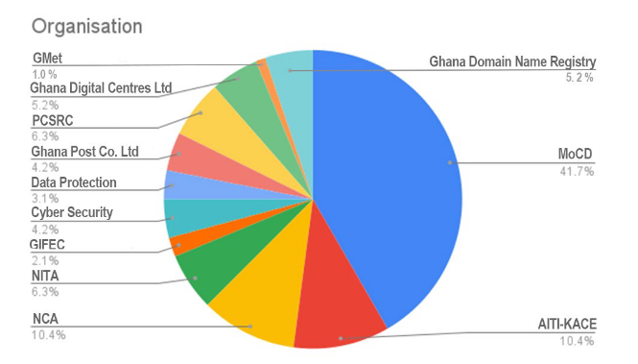
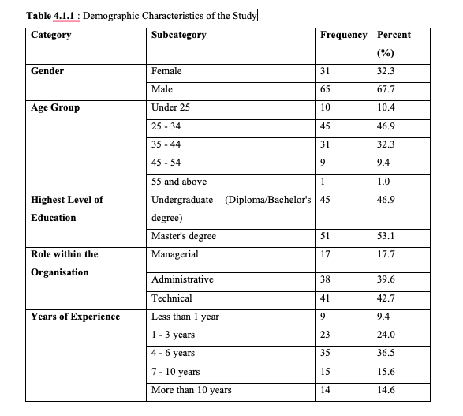
Results
Descriptive Analysis

Slide 9
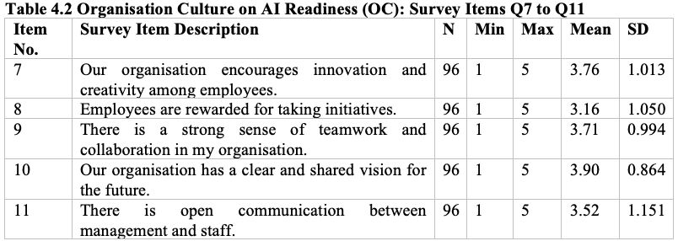
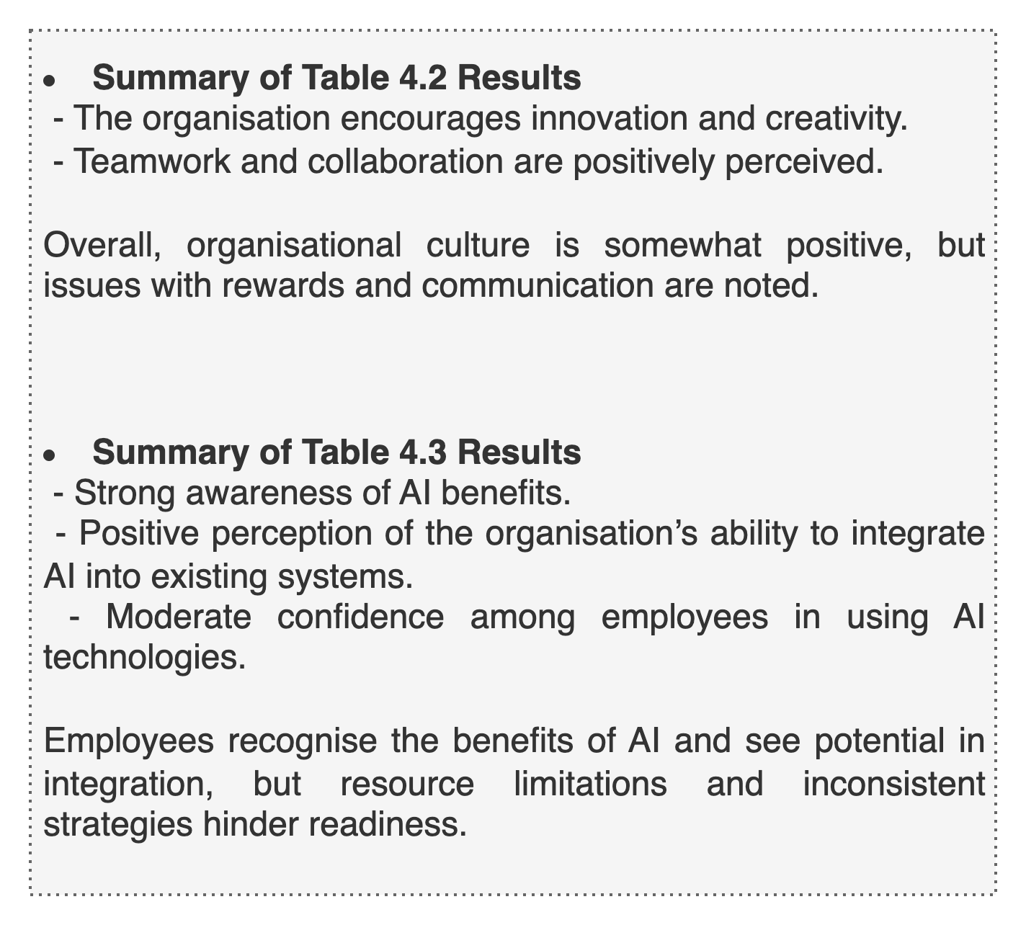
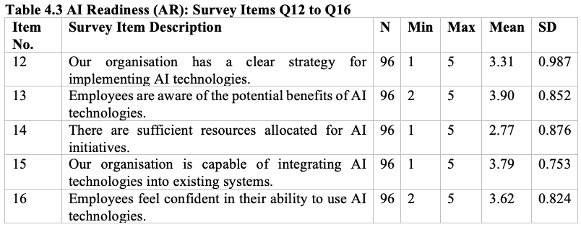
Results

Slide 10
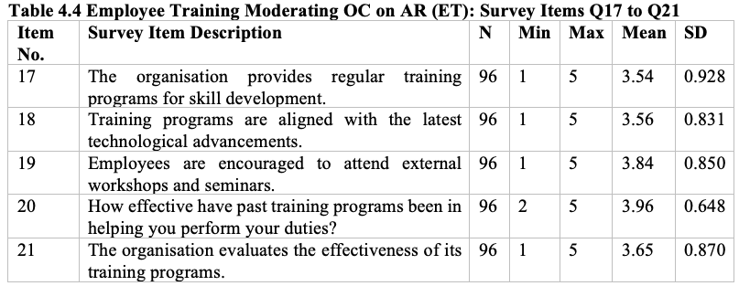
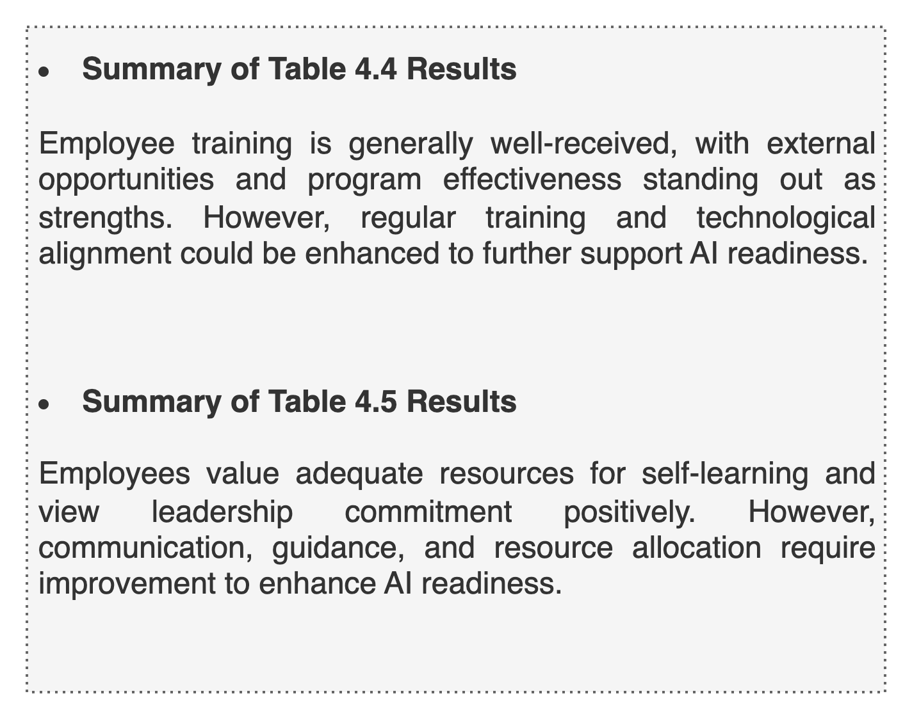
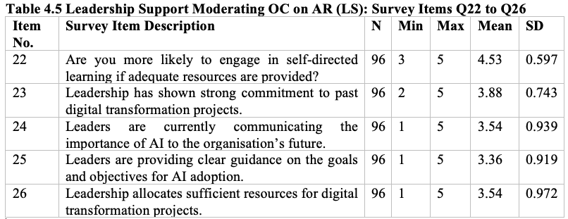
Results

Slide 11
Organisational Culture’s Influence on AI Readiness
Organisational culture has a strong positive influence on AI readiness.
A culture that promotes innovation and provides clarity about the future supports stronger AI integration (Parasuraman & Colby, 2014).
Employees view the Ministry as progressive and strategically focused, with a clear direction that aligns personal roles with broader AI goals.
However, recognition for initiative and risk-taking is seen as lacking. This may discourage experimentation and reduce motivation to engage with AI tools (Caro-Gonzalez, 2024).
While some employees report good communication with leadership, responses vary across departments, suggesting inconsistencies that may affect collective readiness and alignment with strategic objectives.
Notes:
This aligns with research by Ek & Ström (2021), who emphasize the importance of culture in facilitating technological change.

Slide 12
Employee Training Moderating OC on AI Readiness
Employee training strengthens the positive relationship between organisational culture and AI readiness. Training provides the tools and confidence employees need to align with a culture that embraces digital transformation. Structured, continuous training is key for equipping employees with relevant skills and boosting readiness.
Training initiatives that are up-to-date and practically oriented allow employees to seamlessly integrate AI tools into their workflows. External learning opportunities, including workshops and collaborative sessions, expand knowledge and support AI adoption (Ajayi & Udeh, 2024).
Respondents generally viewed training positively, indicating that training initiatives improve individual and team performance. Employees acknowledged the value of structured learning in preparing for technological change, reinforcing the importance of a learning-oriented culture.
Although training is viewed positively, moderate satisfaction with its evaluation mechanisms suggests a need for more robust, transparent, and relevant assessment systems. Employees also called for more AI-specific and practical training content, aligning with Jaiswal et al. (2023), who emphasize targeted upskilling in digital initiatives.

Slide 13
Leadership Support moderation OC on AI Readiness
Leadership support was found to not significantly moderate the relationship between organisational culture and AI readiness. This indicates that culture may operate independently of leadership influence in shaping AI readiness within the Ministry.
Despite the lack of moderating impact, leadership plays a strong direct role in influencing AI readiness. Leaders promote readiness by championing digital transformation, allocating resources, and communicating strategic goals. These actions create an enabling environment for AI adoption (Ajayi & Udeh, 2024; Bell et al., 2014).

Slide 14
Recommendations for Enhancing AI Readiness
1. Foster a Culture of Innovation and Collaboration
Align AI goals with organisational vision and mission.
Promote teamwork and cross-departmental collaboration.
Develop recognition systems for AI-related initiatives.
2. Strengthen Employee Training and Development
Implement regular, practical AI-specific training.
Encourage participation in external workshops/seminars.
Establish structured feedback and evaluation systems.
3. Enhance Leadership Support and Communication
Ensure clear, consistent leadership messaging on AI.

Slide 15
Recommendations for Enhancing AI Readiness
4. Address Resource and Infrastructure Gaps
Invest in digital infrastructure and tools compatible with AI.
Allocate sufficient financial, human, and technological resources.
Leverage strategic partnerships with donors and private sector.
5. Develop Ethical Guidelines for Responsible AI Use
Establish clear policies ensuring fairness, transparency, and accountability.
Form ethics committees and conduct regular audits.
Promote responsible AI adoption to enhance trust.

Slide 16
Challenges and Areas for Future Research
Challenges
The timeframe for conducting the study was limited, which restricted extended engagement and data validation.
Focus on MoCDTI limits generalisability to other sectors or institutions.
Use of digital platforms may exclude less tech-literate employees.
Risk of social desirability bias may affect result accuracy.
Future Research Directions
Broaden the institutional scope to include multiple public sector organisations to improve representativeness.

Slide 17
Conclusion
A culture that promotes innovation, teamwork, open communication, and shared vision is foundational for successful AI integration.
Structured, hands-on AI training programs directly improve staff readiness and enhance the impact of a positive organisational culture. Leadership must still provide clear direction and resources.
Supporting AI readiness improves public service delivery, operational efficiency, and contributes to Ghana’s broader digital transformation agenda.

Slide 18
THANK YOU

