Slide 1
EFFECTS OF SUCCESSION PLANNING ON PUBLIC EMPLOYEES’ JOB SATISFACTION AND PUBLIC SERVICE MOTIVATION IN THE GHANA CIVIL SERVICE
-KNOWLEDGE SHARING:
PRESENTATION-
by
ISAAC KUMI DWAMENA
DEPUTY DIRECTOR, PBMED, OHCS
MASTER OF PUBLIC MANAGEMENT
INTERNATIONAL UNIVERSITY OF JAPAN
SEPTEMBER 2022-JUNE 2024

Slide 2
Presentation outline
Introduction
Main Body: Problem identification, The context of Ghana Civil Service, Research Question, Significance of Study, Research Objective, Hypothesis, Method
Results and Key Findings
Policy Recommendation
Future Research

Slide 3
Introduction: Background of the study
Succession planning is critical for public organizations due to its impact on performance, employee satisfaction, and good governance.
Kolhatkar and Banerjee (2015) defined Succession planning as a process for identifying successors for key positions and planning their career development.
According to Mehrabani and Mohamad, (2011), studies have shown that to ensure long-range stability of management positions, succession planning is required.
Many organizations delay in executing succession planning, and when they do, it is just a paper-based and inefficient process (Corporate Advisory Board. Corporate Leadership Council, 1998)
Scott et al., (2011) showed that Succession planning is an important public management issue in Ghana, and its policies and procedures should encourage the growth of every employee.

Slide 4
Problem identification
Nomalinge et al., (2016) revealed that the lack of comprehensive succession planning in developing nations' public sectors has created various research avenues for scholars and professionals.
Few empirical studies have assessed the relationship between succession planning and employee performance and whether performance and career development evaluation act as a mediating factor(Ali et al., 2019). However, other potential factors, such as job satisfaction and public service motivation were not considered in their study.
Abdullahi et al. (2021) focused on the impact of succession planning on staff engagement and performance in Malaysian private universities, Their study was limited to the academic staff at private universities in Malaysia and self-reported information, which could contain biases or errors. Therefore, their results might not apply to other kinds of institutions and in other countries limiting generalizability.

Slide 5
The context of Ghana
The Ghana Civil Service is a part of the Ghana Public Services. Article 190 of Ghana’s constitution defines our public services.
The function of the Ghana Civil Service is to support the government in the formulation, implementation, monitoring, and evaluation of policies and programs.
In the Ghana’s Civil Service, Succession planning has been mentioned in scattered paper-based documents without a Policy (strategic plan), despite effort made to move employees from one stage to another through various mechanisms.
From 2016, OHCS, the Central Human Resource Management organization for the Civil Service, started to promote succession planning practices within the ministries and departments.
The OHCS outlined a broad stroke of what it expects the various ministries and departments to do. Ministries and departments were responsible for initiating and implementing the succession planning initiative. Some ministries have initiated, while others have not.
This background makes Ghana a perfect case to examine the effects of succession planning on job satisfaction and public service motivation.

Slide 6

Research Question
This thesis aims to answer below the research questions
The questions are as fellows:
How does succession planning affect job satisfaction in the Ghana Civil Service?
What is the relationship between succession planning and public service motivation in the Ghana Civil Service?

Slide 7
Literature gap and Significance of study
The current study aims to fill this gap by assessing the need for succession planning to enhance job satisfaction and public service motivation in Ghana's public sector.
Significance of the study
Not enough information on succession planning in Ghanaian public organizations, especially in the Ghana Civil Service.
This research will contribute to the current status and future directions of succession planning policy within the Ghana Civil Service.

Slide 8
Research objective
The goal of this study is to examine the effects of succession planning on public employee job satisfaction and public service motivation in the Ghana Civil Service.
Specific Objectives
to assess the relationship between succession planning and employee job satisfaction in Ghana.
to explore the relationship between succession planning and public service motivation in Ghana.
to propose measures to improve succession planning in the Ghana Civil Service

Slide 9
Succession Planning and Job satisfaction
Job satisfaction is crucial for organizational success, as it boosts performance, encourages creativity, flexibility, innovation, and loyalty among employees, thus emphasizing the importance of addressing employee satisfaction.
Succession planning, as noted by Collings et al. (2014), demonstrates organizational commitment to career advancement, leading to increased job satisfaction and reduced turnover.
Rothwell (2010) suggests that effective succession planning enhances employee engagement, motivation, and productivity.
According to Rothwell (2000), employees are more likely to be dedicated and produce higher-quality work when they perceive their employer's interest in their professional development.
El Badawy et al. (2016) found a positive relationship between succession planning and job satisfaction.
Hypothesis 1. Succession Planning is positively associated with Job Satisfaction

Slide 10
Succession Planning and Public Service Motivation
PSM. refers to the intrinsic desire or motivation that individuals have to do a certain type of work (that is, serve the public good) or serve the public interest.
Public service motivation (PSM) is the feeling of an individual to act on motivations(intrinsic) primarily related to public institutions (Perry, 1996).
PSM could be utilized in succession planning as a process of identifying people with leadership potential for future leadership, the traits that connect with effective leadership are those that are associated with PSM, such as service, integrity, and trust (Battaglio Jr., 2015)
Individuals' intrinsic motivations, including their sense of duty, desire to contribute to society, and dedication to the public good, are strengthened when succession plan initiatives are formulated and executed to foster career advancement and progression.
Hypothesis 2. Succession Planning is positively associated with public service motivation.

Slide 11
Method
The research was carried out using a quantitative study via survey.
Civil Service Institution | Number
Ministries | 27
Departments | 24
Sample - 300 employees within the ministries and departments in the Ghana Civil Service, which consisted of both professional (senior) and sub-professional (junior)employees.
An online survey using a Google form link to distribute (questionnaire) through emails and other social media devices.

Slide 12
Method cont…
Consent form was designed for participants and were voluntarily agreed upon.
Number of survey items: 27 questions(closed-ended questions) were used to collect primary data.
Returned responses: 225
Valid responses: 222
We used Stata to determine the relationship between Succession Planning and Job Satisfaction and, again, Succession Planning and Public Service Motivation.

Slide 13
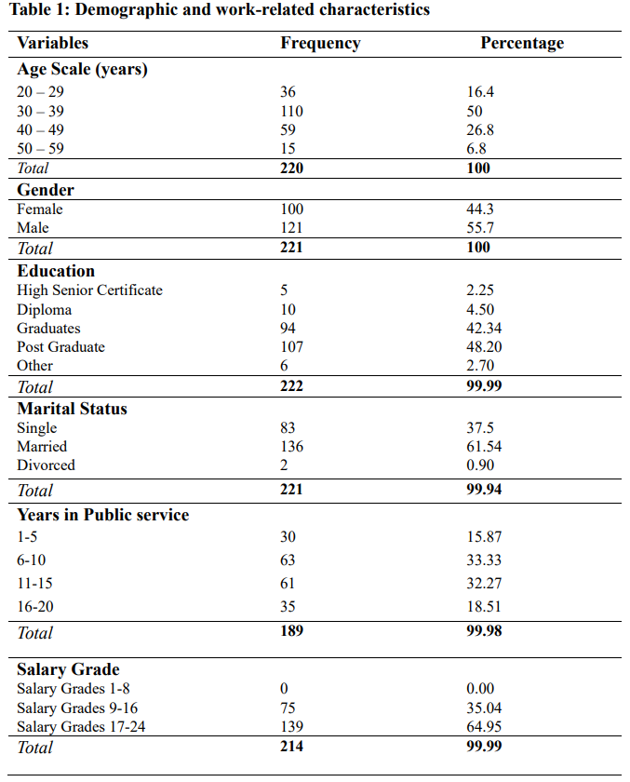
In the civil service, the workforce is generally mature, with a significant presence of both younger and older individuals.
This represents a male-dominated population in the Civil Service
The majority of married employees may indicate that civil service employees will be more committed to the organization's success and long-term professional objectives.
Employees are in higher income grades, which may be linked to more senior or specialized roles within the institutions

Slide 14
Measures
14
Variables | Measures | Response Score
Job satisfaction | Two(2) Questions were developed from questionnaires designed by Wright & Davis, 2003. Eg. Items like “I am very satisfied with the kind of work that I do”. Reliability test: Cronbach alpha was 0.869 | Likert scale ranging from 1 (strongly disagree) to 7 (strongly agree)
Public Service Motivation | 1 to 5 Questions were used from questionnaires by (Wright et al,2013: Xu et al., 2023). For example, items like “Contribution to society is more meaningful than personal achievement”. Reliability test: Cronbach alpha was 0.836
Succession Planning | 1 to 4 Questions were developed to measure Succession Planning. Eg. Items like “The people chosen as future leaders are qualified” Reliability test : Cronbach alpha was 0.880
Control variables | Age, Gender, Marital status, Education, years of work in Public Service, salary grade, years worked in current organization

Slide 15
Regression result:

Slide 16
Regression result (cont’d)
Public Service Motivation | Coef. |  | St.Err. | t-value |  | p-value | [95% Conf |  | Interval] | Sig
Succession Planning | .455 |  | .057 | 7.97 |  | 0.00 | .342 |  | .567 | ***
Age | -.011 |  | .017 | -0.64 |  | .525 | -.044 |  | .023
Gender | .153 |  | .181 | 0.85 |  | .398 | -.204 |  | .511
Marital | -.17 |  | .197 | -0.87 |  | .388 | -.559 |  | .218
Education | -.081 |  | .126 | -0.65 |  | .52 | -.329 |  | .167
Tenure | .018 |  | .016 | 1.18 |  | .24 | -.012 |  | .049
Salary grade | .048 |  | .048 | 0.99 |  | .323 | -.047 |  | .143
Years in current organization | .011 |  | .022 | 0.51 |  | .608 | -.032 |  | .054
Constant | 3.039 |  | .797 | 3.81 |  | 0 | 1.466 |  | 4.613 | ***
Mean dependent var |  | 5.422 |  |  | SD dependent var |  |  | 1.361
R-squared |  | 0.304 |  |  | Number of obs |  |  | 179
F-test |  | 9.289 |  |  | Prob > F |  |  | 0.000
Akaike crit. (AIC) |  | 570.512 |  |  | Bayesian crit. (BIC) |  |  | 599.198
*** p<.01, ** p<.05, * p<.1

Slide 17
Interpretations
The result showed that succession planning has a positive relationship (0.656) with job satisfaction and is statistically significant at a 1 percent level. That is , with all other factors held constant, Job satisfaction is predicted to increase by 0.656 units for organizations that practice succession planning. Thus, Hypothesis 1 is supported.
The result showed that succession planning has a positive relationship (0.455) with public service motivation, which is statistically significant at the 1 percent level. This indicates that for every one-unit increase in succession planning, public service motivation will increase by 0.455 units, holding all other things constant. Thus, Hypothesis 2 is supported

Slide 18
KEY FINDINGS
1. SUCCESSION PLANNING AND JOB SATISFACTION
We found that succession planning has a significant positive effect on job satisfaction. This is supported by El Badawy et al. (2016).
This shows that if the civil service invests more in succession planning initiatives, civil servants are motivated to experience higher levels of job satisfaction. Employees are more likely to be actively involved and dedicated to their jobs when they identify prospects for progress and advancement.
2. SUCCESSION PLANNING AND PUBLIC SERVICE MOLTIVATION
We found that Succession planning positively relates to public service motivation.
That is when succession planning practice exist, employees’ public service motivation increases. When there are clear procedures for employees, and they are recognized and acknowledged for their performance, their inclination to serve the public increases.

Slide 19
Policy recommendation
Comprehensive succession planning policies for entire ministries and departments. That is a formal document that provides clear guidelines or serves as a source of reference document for succession planning.
The policy should be communicated effectively to ensure transparency to all employees.
Prioritize enhancing professional advancement opportunities such as mentoring, coaching, and delegation of assignments to equip the skills and capacity of future leaders.
Must focus on granting greater work autonomy and implementing a system of recognition for high-performing employees to foster public service motivation and uphold employees' job satisfaction.

Slide 20
Challenges
The sample is not representative of the population as a result of the convenience sampling. Therefore, the generalizability cannot be established.
Also the scarcity of theoretical literature examining the association between succession planning and public service motivation.
The survey was conducted online to ensure convenient accessibility for respondents. Unfortunately, the unreliable internet connection in Ghana caused interruptions during the completion of the questionnaire.
Due to limitations in both time and distance, it was not feasible to conduct a survey with a larger sample size as initially planned.
A quantitative approach could not obtain all the in-depth information on succession planning and job satisfaction in Ghana Civil Service.

Slide 21
Future Research
The sample size may be increased to capture respondents in the other ministries and departments in the civil service with more representation to make it more generalizable.
To obtain more in-depth information on succession planning and job satisfaction in public service, future research can use qualitative data such as interviews to understand why.
Other interesting findings with the variables in the regression table (such as age, gender, marital status, education, etc..) did not show a significant effect on job satisfaction. These findings have provided research gaps that other researchers can follow up in the future.

Slide 22
THANK YOU

