Slide 1
A PRESENTATION ON THE GHANA CIVIL SERVICE
MARCH 2021
ING. G. J BROCKE
CHIEF DIRECTOR, OHCS

Slide 2
The Ghana Civil service
The 1992 Constitution of the Republic of Ghana, Article 190 (1) (a) lists the Civil Service as one of the Public Services in Ghana.
Article 193 of the 1992 Constitution requires the President to appoint the Head of the Civil Service.
The Ghana Civil Service included the Local Government Service until it was decoupled from the Civil Service. The current legal framework is the Local Government Act 2016 (Act 936).

Slide 3
Rules and regulations
The enabling legislation for the Ghana Civil Service is PNDC LAW 1993, Act 327.
Objective of the Service:
Is to assist the Government in the formulation and implementation of government policies for the development of the country.
The Civil Service is also governed by the following Rules and Regulations:
Civil Service (Interim) Regulations (1960)
Circulars, Guidelines and Directives
Code of Conduct
Administrative Instructions

Slide 4
STRUCTURE OF THE GHANA CIVIL SERVICE
Civil Service Council
Office of the Head of Civil Service
Sector Ministries
Departments

Slide 5
The civil service council
The Civil Service Council is established by Section 35(1) of the Civil Service Act as the governing body of the Ghana Civil Service.
The President reconstituted the last Civil Service Council in 2017 with the following membership:
Justice Rose Constance Owusu (Chairman)
Nana Agyekum-Dwamena - Head of Civil Service
Justice Henrietta Abban – retired Justice of the Superior Court of Judicature
Mr. Isaac Tetteh Adjovu
Mr. Edwin Philip Daniels Barnes – retired senior Civil Servant
Mrs. Mary Imelda Amadu
Dr. Kodjo Esseim Mensah-Abrampa – rep. of the National Development Planning Commission
Mr. Isaac Bampoe Addo – representative of the Civil Servant Association

Slide 6
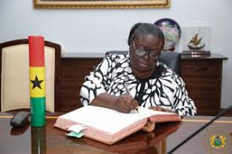
The civil service council
Justice Rose Constance Owusu (Chairman)

Slide 7
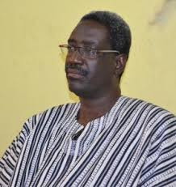
The civil service council
Nana Agyekum-Dwamena - Head of Civil Service

Slide 8
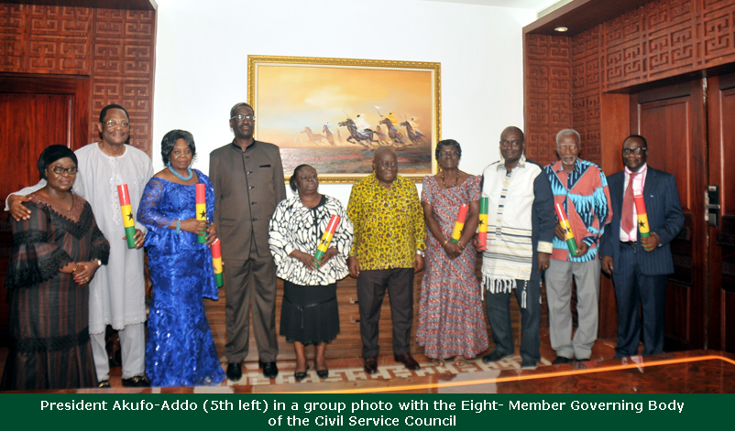
The civil service council

Slide 9
Functions of The civil service council
Deliberate on government policy relating to the management of the Service and suggest recommendations to Government
Promote collaboration between the Civil Service and higher learning institutions to build capacities of Civil Service Staff for effective performance
Advise and promote policies aimed at ensuring that the cost of the Service to Government is not excessive
Periodically review the objectives of the Civil Service to reflect Political, economic, social and cultural changes
Make proposals for enhancing employer (Government) and employee (members of the Civil Service) relationship

Slide 10
Civil service Organisations
The Ghana Civil Service is currently made up of :
Two (2) Extra-Ministerial Organisations;
Twenty-eight (28) Sector Ministries according to the Civil Service (Ministries) Instrument, 2021 (E.I. 12); and
Twenty-three (23) Departments
The two (2) Extra-Ministerial Organisations are:
Office of the President
Office of the Head of Civil Service

Slide 11
Civil service Organisations
The Sector Ministries are:
Ministry of Finance
Ministry of National Security
Ministry of Trade and Industry
Ministry of Education
Ministry of Food and Agriculture
Ministry of the Interior

Slide 12
SECTOR ministries
Ministry of Energy
Ministry of Health
Ministry of Employment and Labour Relations
Ministry of Railway Development
Ministry of Tourism, Arts and Culture
Ministry of Foreign Affairs and Regional Integration

Slide 13
SECTOR ministries
Office of the Attorney-General and Ministry of Justice
Ministry of Transport
Ministry of Defence
Ministry of Sanitation and Water Resources
Ministry of Lands and Natural Resources
Ministry of Parliamentary Affairs

Slide 14
SECTOR ministries
Ministry of Environment, Science, Technology and Innovation
Ministry of Local Government, Decentralisation and Rural Development
Ministry of Gender, Children and Social Protection
Ministry of Communications and Digitalisation
Ministry of Works and Housing
Ministry of Roads and Highways

Slide 15
SECTOR ministries
Ministry of Youth and Sports
Ministry of Information
Ministry of Chieftaincy and Religious Affairs
Ministry of Fisheries and Aquaculture Development

Slide 16
CIVIL SERVICE DEPARTMENTS
Births and Deaths Department
Department of Parks and Garden
Department of Community Development
Controller and Accountant General’s Department
Department of Chieftaincy
Department of Children
Department of Gender
Department of Social Welfare

Slide 17
CIVIL SERVICE DEPARTMENTS
Department of Feeder Roads
Department of Urban Roads
Department of Rural Housing
Hydrological Services Department
Public Works Department
Rent Control Department
Registrar General’s Department
Information Services Department

Slide 18
CIVIL SERVICE DEPARTMENTS
Department of Factories Inspectorate
Department of Cooperatives
Labour Department
Management Services Department
Public Records and Archives Administration Department
Procurement and Supply Chain Management Department
Bureau of Ghanaian Languages

Slide 19
MINISTERIAL ADVISORY BOARD
`
MINISTER
INTERNAL AUDIT
DEPUTY MINISTER
CHIEF DIRECTOR
DEPARTMENT
PUBLIC RELATIONS
GENERAL ADMINISTRATION AND FINANCE
,
PLANNING , BUDGETING, MONITORING AND EVALUATION
RESEARCH, STATISTICS AND INFORMATION MANAGEMENT
TRAINING AND HUMAN RESOURCE DEVELOPMENT
.

Slide 20
office of the head of civil service
MANDATE:
The Office of the Head of the Civil Service (OHCS), as a Central Management Agency, has the mandate to provide the requisite leadership, manage the human resources and promote the organizational development of the Civil Service to enable it respond positively to the needs and aspirations of all its stakeholders
VISION:
A client-oriented organization providing world-class policy advice and services

Slide 21
office of the head of civil service
MISSION:
The Office of the Head of Civil Service exists to manage human resources, and promote efficient records management, organisational development and value for money procurement for the delivery of results-oriented, knowledge-driven services by Civil Service Organisations towards the attainment of national goals.

Slide 22
office of the head of civil service
CORE FUNCTIONS:
Formulate/review the HRM related policies, guidelines, standards and programmes for the service and facilitate their implementation.
Monitor and coordinate all human resource management related programmes in ministries and departments to ensure uniformity in the application of rules and adherence to standards.
Develop and ensure the implementation of a robust performance management system for the civil service.

Slide 23
office of the head of civil service
CORE FUNCTIONS CON’T:
Develop and facilitate the conduct of systematic, competency based training for the acquisition of skills consistent with the needs of the Service.
Exercise oversight responsibility for the management of Civil Service Training Institutions.
Develop record management policies and standards for records keeping in public institutions.

Slide 24
office of the head of civil service
CORE FUNCTIONS CON’T:
Monitor and restructure the record management system and train staff in line with international best practices.
Provide requisite environment for the storage, retrieval and use of archival materials.
Design and institutionalize structures and systems to facilitate effective and efficient delivery of public procurement and Supply Chain management processes in the Civil Service.

Slide 25
office of the head of civil service
CORE FUNCTIONS CON’T:
Develop/review standard operating procedures to guide procurement and supply chain managers.

Slide 26
CIVIL SERVICE COUNCIL
`
REFORM COORDINATING UNIT
HEAD OF CIVIL SERVICE
INTERNAL AUDIT
MANAGEMENT SERVICES DIVISION
PROCUREMENT & SUPPLY CHAIN MANAGEMENT DEPARTMENT
PUBLIC RECORDS AND ARCHIVES ADMINISTRATION DEPARTMENT
PUBLIC RELATIONS
CHIEF DIRECTOR
CIVIL SERVICE COUNCIL SECRETARIAT
CAREER MANAGEMENT DIRECTORATE
PLANNING , BUDGETING, MONITORING AND EVALUATION DIRECTORATE
RESEARCH, STATISTICS AND INFORMATION MANAGEMENT DIRECTORATE
GENERAL ADMINISTRATION AND FINANCE DIRECTORATE
RECRUITMENT, TRAINING AND DEVELOPMENT DIRECTORATE
,
Career and Succession Planning
Research, Statistics
Manpower Planning, and Budgeting
Performance Management Standards and Review
Administration
Policy and
Development Unit
Information Management
Recruitment
Client Services
Central Personnel Registry
Training and Development
•
.
Finance
Reform and
Policy Coordination
Salary and Compensation Administration
Social Dev’t Unit
Civil Service Training
Institutions

Slide 27
CHIEF DIRECTOR & directors (OHCS)
Mr. Godwin J. Brocke – Chief Director
Mr. Pethuel Danyo – Director, Administration
Mrs. Eunice Osae - Director, Career Management Directorate
Mrs. Elizabeth Obeng-Yeboah - Director, Recruitment, Training & Development - Ag. Director, Reform Co-ordinating Unit (RCU)
Mrs. Mavis Asare-Donkor - Director, Planning, Budgeting, Monitoring & Evaluation Directorate
Mr. Fred Anson - Director, Research, Statistics & Info. Management Directorate
Mr. Daniel Nartey – Director, Internal Audit

Slide 28
List of directors
PRINCIPALS OF OHCS TRAINING INSTITUTIONS:
Mrs. Dora G. Dei Tumi - Chief Training Officer, Civil Service Training Centre (CSTC)
Solomon Nobi Amanor - Chief Training Officer, Government Secretarial Schools (GSS)
John N.O Welbeck - Chief Training Officer, Institute of Technical Supervision (ITS)

Slide 29
List of directors
DEPARTMENTS:
Mrs. Thelma Ewusi – Acting Director, Public Records and Archives Administration Department (PRAAD)
Ms. Norma Onny – Acting Executive Secretary, Management Services Department (MSD)
Mr. Ebenezer Agyekum – Acting Director, Procurement and Supply Chain Management Department

Slide 30
MEMBERSHIP OF THE SERVICE
(a) A person serving in a civil capacity in a post designated as Civil Service post by
or under this Act in,
(i) the Office of the President,
(ii) a Ministry,
(iii) a government departments at the national level;
(iv) any other civil service department established by or under the authority of this Act the emoluments attached to which are paid directly from the Consolidated Fund or other source approved by the Government, and
(b) A person holding a post designated as Civil Service post created by or under the authority of any other enactment, the emoluments attached to which are paid directly from the Consolidated Fund or other source approved by Government.

Slide 31
CHARACTERISTICS OF THE CIVIL SERVICE
Bureaucratic
Hierarchical
Anonymity
Neutrality
Loyalty

