Slide 1
Knowledge sharing resilience of Service delivery during covid’19 pandemic: the case of the e-government in the Ghana civil service
charity m. addey assistant director iia
office of the head of civil service
KOICA- MASTER’S IN PUBLIC ADMINISTRATION
Sungkyunkwan University, Seoulsouth korea
22ND MAY 2023

Slide 2
OUTLINE
BACKGROUND of the programme
INTRODUCTION
OBJECTIVES
SCOPE AND TIMELINES
FINDINGS
RESULTS
OBSERVATIONS
LESSONS LEARNT
ACHIEVEMENT (KNOWLEDGE AND SKILLS GAINED)
EXPERIENCES/EXPOSURE
CHALLENGES
IMPLICATIONS OF THE STUDY ON THE CIVIL SERVICE (INNOVATION/NEW IDEAS)
CONCLUSION
RECOMMENDATION

Slide 3
Background of the programme
The Master’s in Public Administration program in Public Administration aimed to strengthen the capacity of civil servants and local government officials by providing participants with an integrative educational program with a balanced curriculum. These enhanced managerial skills and analytical policy expertise.
To develop skills, expertise, and flexibility required to be capable government leaders and professionals.
To secure analytical skills to devise concrete solutions to unique and complex problems facing cities, rural areas, and others.
To apply theoretical learning to practice.
To share Korea’s successful experience and expertise in strengthening local governance with many developing countries around the world, in the hope that this can enhance their ability to further their expertise in the areas of economic development and better quality of life at the local level; and
To conduct academic research in order to raise understanding of local government administration/management as well as to improve public administration and public policies.

Slide 4
MODULE (SUBJECT AREAS)
CURRICULUM-INTENSIVE AND 3 CREDITS ON ALL SPECIALIZATION COURSES
MODULE
Seminar in Survey Research Methods
Local Government Internship
Academic Writing and Research Ethics
Local Government and Public Administration
Urban Mobilities
Special Lectures/Seminars
MODULE
Management Science and Statistical Methods
Seminar on Policy Evaluation
Understanding the Dynamics of Public Policy Process & Governance
Smart E-Government and E-Policy: Theory & Korean Policy Case
MODULE
Disaster Management for the future
Seminar on Public Human Resource Management
Korea Language Class
Introduction to Korea Law
Orientation and Fire Drill (Safety Education)
Understanding of Platform Processes for Korean Public management

Slide 5
Rationale behind the course
Rationale
To educate/ share knowledge with public officials in the field of Public Administration especially e-government to enhance their competencies in service delivery.
JUSTIFICATION
To provide resourceful experiences in Public policy and Public administration services that would improve my work/effort on socio-economic development in the civil service/ developing countries.

Slide 6
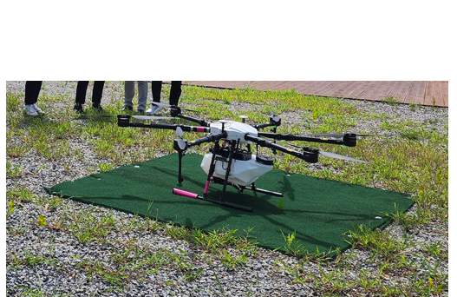
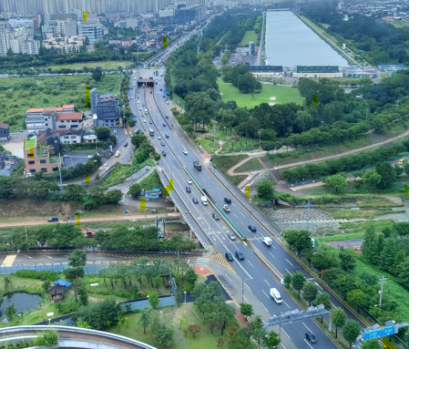
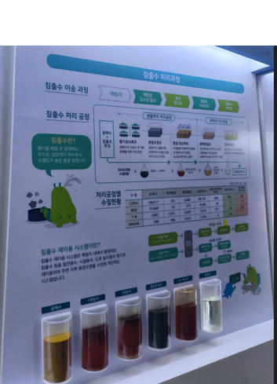
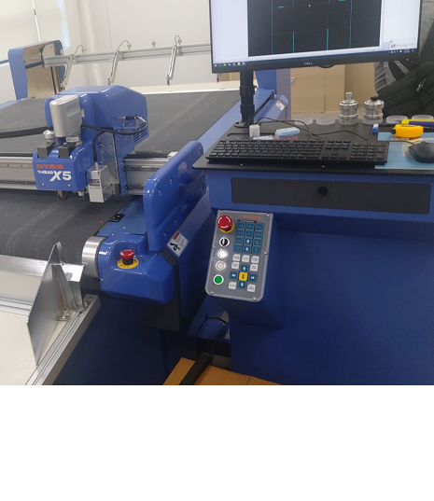
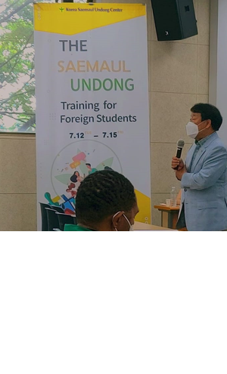
Korea experiences

Slide 7
scope
The program started on the 1st August 2021 to 31st January 2023.
Students successfully completed the program and departed from Korea in December 2022.
This presentation is to share lessons learnt, unique experiences, knowledge acquired, and the outcome of the training program. Colleagues will be taught best management practices and work ethics, skills, and experiences acquired with relevant examples from Korean public service and networking.
Further to enhance the understanding of the Korean experience that human resources played a crucial role in national development by partnering with diverse organizations, etc.

Slide 8
introduction
Covid’19 Pandemic creates a climate of uncertainty among citizens and places a significant strain on their resources as they deal with incomparable challenges that have resulted in a new normal in almost every sphere of societal, educational, technological, economic, environmental, and political life.
1
The Initiative of dimension should be the best progress of service delivery on recovery from COVID-19 pandemic effects on technology for ICT/IT infrastructure and human resources to communicate policies implementation.
2
The extent to which productivity is affected negatively or positively in the service.
3
The situation of motivation established in their organizations to encourage commitment, punctuality, diligence, etc.
4
Prevalence of expedition on treatment, wellness, and hygiene from health assistance in the organization.
5
Economic strategies for resilience for sustainable best technologies, policy measures, compliance on government regulations, and supports from stakeholders.
6
The mitigation goal is to keep the country's economic growth sustainable goals 9 on the industry, innovation, and infrastructure, 17 on partnerships for development, 3 on good health and well-being, and 8 on decent work and economic growth.
7

Slide 9
Objective/ purpose
Objective
To investigate the resilience of service delivery during the prevalence of the COVID-19 pandemic in the civil service.
To focus on identifying the issues of resilience, technology, productivity, motivation, and prevalence.
Purpose
To investigate the existing kinds of literature and by interpreting the correlation of linear relationship, and the estimate to test the logit regression model affects resilience (dependent variable) and technology, productivity, motivation, and prevalence are independent variables. Regression to determine the relationships between predictor-independent variables in the concepts.
what system of administrative functions was useful during/after the covid-19 pandemic?
How does the organization motivate punctual and committed officers during the first stage of the covid’19 pandemic?
when would your organization establish a disaster management team to strengthen mitigation, preparedness, response, and recovery measures?

Slide 10
Research question
What is the role of technology, motivation, and prevalence aiding to productivity on the resilience of Civil Service staff under an alternative working arrangement during/after the COVID’19 pandemic.
What is the impact of government and management support in aid to improve the productivity of Civil Service institutions
What is the possible best model aiding to the resilience of Civil Service staff on productivity.

Slide 11
Significance of the study
To contribute to the impact of flexible working arrangements during/after the outbreak of covid’19 pandemic
To elaborate on the existing kinds of literature and amended with the resilience of service delivery during post Covid’19 pandemic.
To identify and uncover new concepts, and ideas that need to be incorporated.
How organizations conducted workplace safety for staff.
What kind of safety precautions are operationalized in the organization?
How disaster management team was established or strengthened mitigation, measures?
How the organization intends to implement IT and digitalization working services in near future.
How do management and board have a strong commitment to promoting information technology adoption and implementation in the organization,
What kind of ICT was useful in the execution of daily administration functions in their organization, and measures which staff was motivated?

Slide 12
LITERATURE REVIEW
COVID-19 pandemic has brought major disruptions to economic activity across the world (Calderon et al., 2020). The economic growth in sub-saharan Africa would decline from 2.4 percent in 2019 to -2.1 to -5.1 percent in 2020, the first recession in the region in 25 years (Calderon et al, 2020).
If the right measures are not taken in the current period, the post-covid-19 era may be difficult with many African states struggling to meet the growing expectations of citizens whose livelihoods would have been severely bollix or irretrievably destroyed by the unintended consequences of enacting unworkable lockdowns (D.Willy, 2020).
Policymakers in affected African countries must have the best available data and understanding of covid-19 epidemiology to inform any course of policy action (D.Willy, 2020)

Slide 13
LITERATURE REVIEW
We need to tap into technology to do evaluations/fittings and use personal protective equipment to go into homes for things that are unadorned via technology (SP, AM).
The effort to develop novel best practices for service delivery in similar circumstances would ensure “preventative measures are known and applied (resulting in) developing the capacity of the sector to a ‘digitally transformed’ service mode (SP, EU)”
Resilience became a key focus during times of crisis. As we served our clinicians that served our communities, burnout was a common theme. Our providers across the nation served our communities surge after surge. Our people had impacts on our very own and their families influenced. When we reflect on resilience, we certainly reflect on the kintsugi bowl, coming out stronger from some of the toughest moments in time.
Human resilience
Technology resilience
Organizational and talent resilience
Partnerships
Rising to the occasion and seizing the moment
Being savvy about fiscal management

Slide 14
RESEARCH METHODOLOGY
The research methodology principally employed the deductive and inductive approach extensive review, and content analysis of both the primary and secondary data including data collected through survey questions, observation, government websites, newsletters, academic articles, and scientific articles such as plans, policies, programs, and other official functions. Also, a field exploratory study that relies on gathering basic information from observations, and questionnaires. Reaching results from the study by testing the research hypothesis, using the necessary statistical tools for analysis, and proposing the best strategy, and initiative for the Civil Service. Consider similar case studies in the adaptation of the report in both South Korea and Ghana. The targeted populations are the Civil Servants in Ghana categories in four (4) stages; management staff, Senior level Officers, middle-level Officers, and Junior-level Officers.

Slide 15
THEORETICAL MODEL
Kingdon’s Model: This model dictates that there are three (3) streams affecting the policy; namely problem, policy, and politics. They flow independently and the most important factor is the triggering event or focus event (covid-19) which consists of dramatic event or political event (kwon, 2021). Example covid-19 crisis. In relation to the research understudy, the agenda settings established same social problem that gives alternatives to helps as public agenda than government agenda.

Slide 16
Logical Ground
Time preference focused on the questions of the investigation of strong civil service on resilience during the COVID’19 pandemic on service delivery in Ghana by suggesting solutions to the current challenges, issues, and analysis. To propose the best strategy and initiatives for the Civil Service.

Slide 17
Theoretical framework
This research on resilience of service delivery during COVID-19 pandemic; have five (5) conceptual variables to be develop namely resilience, technology, motivation, prevalence, and productivity.
Technology
Control Variables
Age
Gender
Academic background
Qualification
Grade/Occupation
Motivation
Productivity
Resilience
Prevalence

Slide 18
Research design
Research Design
The importance of methodology to every research cannot be overstated if the validity and reliability of the results are attained.
I was involved in specific data analysis techniques or methods as a researcher. This study employed the research survey method as the researcher focused on resilience in service delivery during the covid-19 era in civil service as data was drawn from the ministries, departments, and institutions. The process is through Google form online administration on necessary platforms.
Data Collection
This study employed primary and secondary data for analysis. Primary data was gathered through the administration of a paperless questionnaire from the survey using a Google-linked questionnaire format. Primary data is a field exploratory study that relies on gathering necessary information from surveys, and questionnaires reaching results from the study by testing the research hypothesis, using the latest statistical tool (SPSS 22.0) for coding, and analysis.

Slide 19
Sample size
SAMPLE SIZE
Sample for the study was 300 participants (N=300) selected purposively from the Civil/Public Sector in Ghana. Females (197) were more than Males (103) in the study.
The sample provides data from which to draw conclusions about some larger group, the population, whom these people represent.
PILOT TESTING OF THE INSTRUMENT
Once a survey or questionnaire is developed, it should be pilot tested. These pre-tests, prior to launching the survey to the identified audience, help to determine any failures in the survey instrument, poorly worded or unclear questions, or inappropriate or erroneous response categories. The instrument for the data collection tested through piloting to infer how the main survey would be.

Slide 20
METHOD OF ANALYSIS
Data employed IBM (SPSS 22.0) edition for the preliminary, descriptive analysis, and further analysis.
Data was coded and analyzed using the software SPSS and collated data generated by Excel template.
Preliminary analysis involved descriptive analysis with tabulations while
Further analysis applied logistics regression, correlation, and regression model.

Slide 21
findings
Hypothesis statement tested by scientific research helps the researcher to know the relation between two or more variables in the experiment or data collection. This contains the criteria of effectiveness, efficiency, equity and adequacy, political, economic, social, administrative, legal and technical.
H_{I}: | Can Civil Service staff with the effort of (technology, prevalence, and motivation) help to improve on productivity under alternative working arrangement?
H_{II}: | Organization resilience is dependents on Civil Service staff efforts on (technology, prevalence, and motivation) leading to productivity
H_{III}: | How staff adopt to the new system of working during the COVID-19 pandemic
H_{IV}: | There is positive relationship between Productivity and the resilience of service delivery during post Covid-19 pandemic
H_{V}: | There is positive relationship between Technology and the resilience of service delivery during post Covid-19 pandemic
H_{VI}: | There is positive relationship between Motivation and the resilience of service delivery during post Covid-19 pandemic

Slide 22
Empirical research
Preliminary Analysis
Highest level of education and position held in the organization
Knowledge and experience about Public Administration

Slide 23
Data analysis on daily functions and lifestyle towards work
Variable in question | Variable | (%) | $ρ$-value | $Sig$-value | chi-value
Do you have personal computer at home and access to Internet? | Yes No | 217 (72.3) 83 (27.7) | 0.29 | 0.00 | 25.27
What location were you working during the COVID crisis? | Workplace Home Siren environment Others | 176 (58.7) 121 (40.3) 1 (0.3) 2 (0.7) | 0.212 | 0.001 | 17.695
Are you working productively under an alternative working arrangement? | Yes No | 159 (53.0) 141 (47.0) | 0.189 | 0.001 | 10.673
Are you communicating and interacting effectively during alternative working arrangements? | Yes No | 218 (72.7) 82 (27.3) | 0.018 | 0.753 | 0.099
What kind of Information Technology system are you using during alternative working arrangements? | Zoom Smart e-workplace Emails Virtual infrastructure Team viewer WhatsApp E-workplace | 107 (35.7) 101 (33.7) 1 5 (5.0) 29 (9.7) 16 (5.3) 10 (3.3) 15 (5.0) | 0.016 | 0.469 | 6.628
Source: Field Survey, 2022

Slide 24
Investigating time preference of resilience in service delivery
TECHNOLOGY INFORMATION
Variable in question | Variable | (%) | $ρ$-value | $Sig$-value | chi-value
To what extent did the established ICT system help with Job Schedule delivery in your organization? | Very good Somewhat good Bad extent Very bad Neither good nor bad | 86 (28.7) 55 (18.3) 26 (24.0) 4 (1.3) 83 (27.7) | 0.47 | 0.827 | 1.497
What innovations were adopted to mitigate the impact and improve service delivery during the pandemic? | Obeying the Covid protocols Meeting on Zoom to work Rotation of staff on every week from home Scheduling and booking of appointment No Innovation adopted | 52 (17.3) 131 (43.7) 25 (8.3) 70 (23.3) 19 (6.3) 3 (1.0) | 0.096 | 0.000 | 36.291
What kind of ICT is useful in the execution of daily administration functions in your Organization? | Smart workplace Zoom Emails Ms. Outlook E-workplace WhatsApp Others | 105 (35.0) 42 (14.0) 49 (16.3) 19 (6.3) 17 (5.7) 37 (12.3) 31 (10.3) | 0.294 | 0.000 | 41.802
Source: FieldSurvey, 2022

Slide 25
CORRELATIONS MATRIX FOR THE VARIABLES
Variable | Technology | Productivity | Motivation | Prevalence | Resilience
Technology | 1 | 0.126* | 0.284** | 0.179** | 0.104
Productivity | 0.126* | 1 | 0.376** | 0.467** | 0.472**
Motivation | 0.284** | 0.376** | 1 | 0.358** | 0.413**
Prevalence | 0.179** | 0.467** | 0.358** | 1 | 0.705**
Resilience | 0.104 | 0.472** | 0.413** | 0.705** | 1

Slide 26
CASE STUDY
Survey conducted on Resilience, Occupational, Stress, Job Satisfaction, and intention to leave among nurses and midwives during Covid-19 pandemic
Comparatively, a study conducted by sygit-kowalkowska (2022) on “resilience, occupational stress, job satisfaction, and intention to leave the organization among nurses and midwives during the COVID-19 pandemic” results show that data collection included 441 participants.
The questionnaires were completed in full by 390 people (96.7% women and 3.3% men), aged between 22 and 66 (M = 44.48; sd = 10.68).
The largest group was comprised of people with job experience of over 30 years (29%) (sygit-kowalkowska, 2022). The questionnaires were completed in full by 390 people (96.7% women and 3.3% men), aged between 22 and 66 (M = 44.48; sd = 10.68).
The largest group was comprised of people with job experience of over 30 years (29%) (sygit-kowalkowska, 2022).

Slide 27
CASE STUDY
Civil Service survey on Covid-19 Impact
According to the survey conducted by “Ghana survey on public service response to COVID-19” (GSPSRC-19, 2020) on resilience of public sectors in Ghana, its findings were that, of the 191 surveyed civil servants, 28% of them are in managerial positions. In OHCS, this is 18%.
Looking at basic demographics 92% of surveyed officials are working full-time, and only 5% of officials are currently working part-time. 48% of respondents are women, and the average age of surveyed officials is between 30 and 39 years old.
The survey outcome were that, 60% of managers surveyed stated that their organization had instituted flexible working hours, while 27% of managers said that their organization adopted mandatory home-based working. Only 13% of managers said that civil servants in their organization are working exclusively from the office.

Slide 28
OBSERVATIONS
South Korea is well experienced/advanced in controlling pandemics which Ghana can learn few procedures at their advantage.
Combination of the scientific and technological innovation and economic wealth that have been accumulated in the society made breakthrough to open a new civilization called industrial society. The Civil Service is not at that level yet.
Modernization of industrial society means to dominate the nature with the power humans and machine that is practiced in the Asia countries for development than Civil Service Ghana.
Societal transformation is based on transition of knowledge by educating and training in ICT, South Korea is more advance in these specialization than Ghana and resourceful for development.
Saemaul Undong spirit of Diligence, Self-help and Cooperation can be implemented in Ghana for Community Development.
Waste Segregation can be intensified in Ghana for resourceful use of waste and management as the advance countries.

Slide 29
LESSONS LEARNT
The programme detailed intensive participation in every area of study like lectures, field strips and internships.
One needs to read a lot and carried out research, contributing at programs and time conscious.
Students/ citizens are well dressed and their culture being practiced continuously,.
Human surveillances, CCTV and online tracking are very intensive.
Technology advancement is high which I have acquired knowledge on online apps for movement to any location, bus, train, lectures on icampus, ilibrary, online purchasing etc.

Slide 30
achievement
2023 8th Academic Conference for Graduate in Public Administration.
Saemaul Undong Training as Delegate for Ghana’ 2022
Article published in MPM Insight vol.2, South Korea, 2023
A webinar on the future of Public Management, Administration, and Governance Education in the Philippines, 2022
2022 Korean Association for Public Administration (KAPA) International Conference
Leadership forum conducted by the National Humann Resources Development Institute of the Republic of South Kore, 2021
Brining Back Equity and Ethics in Phillippine Public Administration and Governance: A public sector reform agenda for the New Administration, 2022

Slide 31
CHALLENGES
Insufficient allowances
Inadequate ICT/IT applications installation on PC and usage
High cost of living
High level of racism
Unfriendly environment among foreigners
Inadequate flow of information and communication among foreigners/Koreans
Extreme Intimidations

Slide 32
NEW IDEAS/INNOVATION
Support Individual and culture need to promote self-motivation with capacity building like training systems at all levels, review of policies, and reform initiation at organizations where necessary.
Propose digital innovation in civil service to empower institutionally driven forces, with strong and resilient labour market following innovation pathways that are not filtering currently.
First phase of Project Plan
Policies on Digital
of the Civil Service
ICT Technology development for business transaction and Government operations
Legal Management of Citizens and Government
Strengthen the Industry and Economy on Digitalizing the Service and Providing necessary incentives to staff as motivation
Strengthen Being savvy about fiscal management

Slide 33
PRACTICAL IMPLICATIONS
Increasing the access and use of technology,
Strengthening internal communication approaches to better support remote working and virtual in-person activities, and
Designing further diagnostic tools to identify specific constraints and bottlenecks
Implementing their core tasks were poor access to the internet,
Sufficient proper equipment,
Managing work that requires in-person interaction, and access to the necessary documents.
Support of the government to the public sector, resilience from the public sector increases and hence productivity also increases.
Government support can be asking for aid or signing MOU with South Korea for strong technology operation and digitalization as well as management support for implementations.
Government regulations play an essential role with policy creation, system structures and cultural practices in the organization.

Slide 34
Conclusion/recommendations
Management and board were committed to promoting information technology adoption and implementation in their organization. Furthermore, the management board was willing to allocate resources for implementing IT/ digitalization systems in their organizations.
Technological advancement and digitalization should be enforced in the public sector to help build the economy
Lay down better policies from the government for any future pandemic outbreak
Building a better Ghana’s technological advancement and digitalization is the way to catch up with the advancement of the Western world. Stronger institutions and best policy practices enforced and maintained by the government and policymakers
There should be sensitization and more education to the public on covid-19
Motivation is important in terms of extrinsic or intrinsic because human motivation according to porter and Miles (1974, p.546) is what rejuvenates a person’s behaviour, what put them on the right track of it, and what retains and sustains it

Slide 35
A call to action
Serviceable knowledge and competencies to staff, help to increase productivity, and incomes, and contribute to economic growth,
Developing effective tactics to ease the negative psychological impact.

Slide 36
Questions and answer

Slide 37
Thank you for your attention, please

