Slide 1
MINISTRY OF COMMUNICATIONS AND DIGITALISATION
PRESENTATION ON STUDY OF MASTERS DEGREE IN PUBLIC ADMINISTRATION (GLOBAL e-POLICY AND e-GOVERNMENT)
GRADUATE SCHOOL OF GOVERNANCE, SUNGKYUNKWAN UNIVERSITY
PRESENTED BY
GLORIA ADJASAH (AD1)
23RD NOVEMBER, 2021

Slide 2
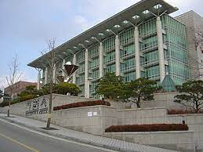
Introduction
Sungkyunkwan university literally means an institution for building a society of perfected human beings.
Was established in 1398 (formerly a royal academy)
It’s a private comprehensive research university. It has two campuses
Humanities and Social Sciences in Seoul
Natural Sciences campus in Suwon
SKKU’s motto, Su Gi-Chi-In, which means Benevolence, Righteousness, Propriety, Wisdom

Slide 3
Programme Overview
Pogramme Title: Master’s Programme in Global e-Policy and e-Government
Duration: 31st July 2016- 23rd June 2017 (11 Months)
Objective of the program
The program has the following objectives.
To equip a broad range of analytical competency to devise concrete solutions to unique and complex problems facing cities, rural, and urban centers in a globalized world.
To share the Korean successful local governance experience and knowledge with other developing countries, which would enhance their ability to further their expertise in the areas of economic development and quality of life at the local level.
To conduct academic research to enhance the understanding on local government administration/management as well as capabilities of public administration and public policy

Slide 4
Programme Overview cont.,
No. of Participants : 18
(Cambodia, Cameroon, Cote d’Ivoire, Ecuador, Egypt, Ethiopia, Fiji, Ghana,
Indonesia, Mongolia, Mozambique, Pakistan, Senegal, Sri Lanka, Tanzania, Tunisia,
Uganda and Uzbekistan)

Slide 5
Personal objectives
To broaden my understanding of policy Planning and Implementation
To Enhance my Administrative and Research Skills
To Learn the Korean Hard Trick of Rising From Receivers To Donors

Slide 6
Programme Content
Pre-semester
Korean Culture and Languages (Non Curricular)
2nd Semester (2016)
Survey and Research methods
Winter School (2016)
Internship at Gimpo International Airport
1st Semester (2017)
E-Government and public policy

Slide 7
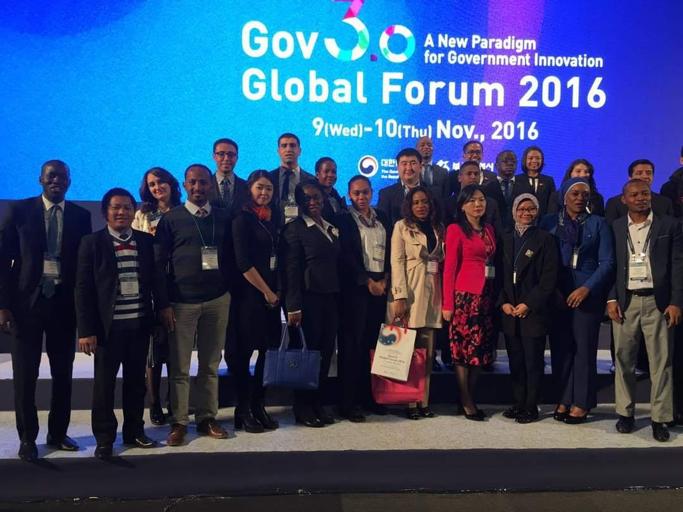
Conference of e-Government& e-policy studies
Cultural visits
Notes:
These are some still pictures of the activities I participated in

Slide 8
Special lecture
Field trip

Slide 9
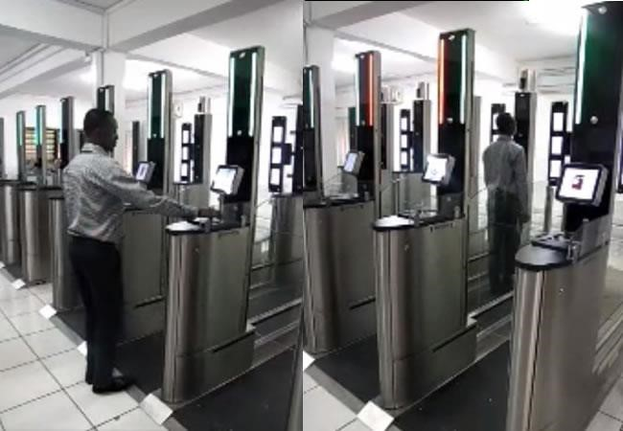
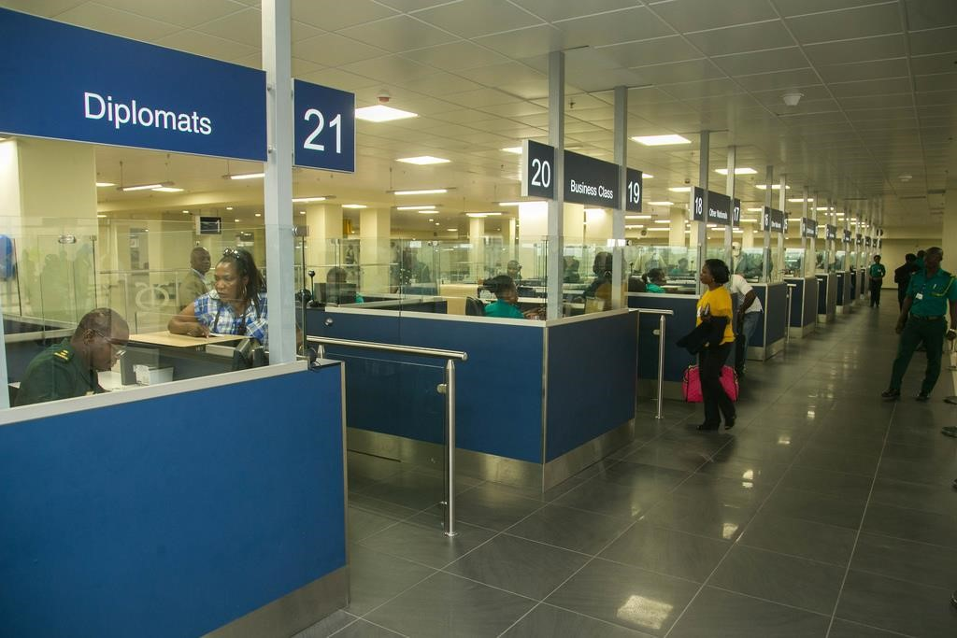
Assessment of the Factors Contributing to Airport Users’ Use of E-immigration System (E-gates) Implemented by the Ghana Immigration Services at The Kotoka International Airport
Supervised by: Rosa Minho Cho, Ph.D.

Slide 10
Background & Objective of the Study
Ghana E-Government Strategy 2006
e-Ghana Project World Bank Supported
Huawei- Technology Partner
Ministry of Communication
electronic gates -electronic visa and border control solution powered by biometrics
automated passport inspection and tracking border crossing events, online portal service for visa applications
improve intelligence sharing
improve delivery of services to citizens and other nationals
improving the internal processes of the Ghana Immigration Service
E-Immigration
(E-Gates) Automated Border Control System
Study sought to assess the factors that contribute to airport users’ satisfaction in the usage of this e-immigration system at the Kotoka International Airport in Accra, Ghana
Understanding what drives user satisfaction and enlighten the implementation agencies on possible changes to the system that will increase the level of usage and user satisfaction.

Slide 11
Research Questions
How does Information Technology Factors of Ease of Use, Usefulness and Service Quality affect the level of usage satisfaction of Ghana Immigration Service, E-gate System?
How does User’s Behavioral Factors of Capacity Culture (Knowledge) and user attitude towards E-gates influence or affect the level of usage satisfaction of the E-gate system among citizen end users?
How does Institutional and Environmental Factors of Administrative/Operational Support and Infrastructural Capabilities affect the usage satisfaction of the e-gate system by airport end users in Ghana?

Slide 12
Conceptual Model of the Study
Information Technology Factors- TAM
User’s Behaviour Factors- TRA
Usefulness
H1
Capacity Culture
H3
Ease of Use
H2
Airport User Satisfaction of ABC (E-Gates) System
Attitude towards ABC (E-Gates) System
Service Quality
H7
H4
H6
H5
Administrative/Operational Support
Airport Infrastructure Capabilities
Institutional Factors and
Environmental Factors- Institutional Theory
Control Variables: Age, Level of Education, Gender, Previous Experience with ABC System

Slide 13
Hypotheses
Hypothesis
H1 | Perceived usefulness has positive effects on user satisfaction of ABC system
H2 | Perceived ease of use has positive influence on user satisfaction
H3 | Capacity Culture/knowledge (Self-efficacy) will affect SSTs user satisfaction positively
H4 | User attitude is positively related to user satisfaction
H5 | Administrative support positively related to user satisfaction
H6 | Airport infrastructure capacity is positively related to user satisfaction
H7 | ABC (e-gate) system’s perceived service quality will have a positive effect on customer overall satisfaction.

Slide 14
Methodology
Methodology
Mixed research approach was used to collect the data for this study
The study targeted 250 passengers out of those who use KIA.
Primary data was collected using a survey and face to face interview using an interview guide. Questions were framed using a 7 point Likert Scale ranging from 1 (low level) to 7 (high level) to measure how variables affect user satisfaction of the E-Gates system at the Kotoka International Airport.
Interview questions (qualitative) centered on operational challenges faced by operators and managers of the E-Gates System at KIA.
Secondary data(quantitative) on measurements of operating metrics for the system. - number of people using the system per day, month and year and number of down times of the system in a day, month and year.
Data collected was analyzed using Descriptive Demographic Analysis(DDA), Confirmatory Factor Analysis (CFA) and fit statistics and correlations analysis to find out relationships among the variables. Regression Analysis was used to test the model, and empirical findings explained.

Slide 15
Results
Results
Results of the survey
Ease of use, usefulness, Administrative Operations, infrastructural capacity and service quality were all significantly related with user satisfaction with the e-Gate system. This shows that the technological factors and environmental and institutional factors explain user satisfaction.
Operational Challenges with KIA E-Gates System (result of the interview)
Readability of electronic passports: Typical causes of false rejections include people not looking at the camera or poor quality photos stored in electronic passports.
Tailgating: Two persons try to go through an e-Gate at the same time, which solicits the help of immigrations officers to stop them and the reason for the behaviour clarified and the travelers processed accordingly.
e-Passport is wrongly placed into the reader: travelers sometime place their Passports into the reader in the wrong way, and they have to be assisted by through hand-to -hand guidance by the assisting personnel.

Slide 16
Policy Implications of the study results
Provide clear instructions or built-in simulations (e.g., a step-by-step demonstration of how it works on digital displays and posters will equip users with necessary skills and abilities, in flight demonstrations, a page in in-flight magazines, Audio announcements)
Launch promotional and Educational campaigns that will serve as incentives to encourage passengers to experience the system.
Increase administrative/operational support for users, use of ‘‘greeters’’ and assistants at service points (gates) to assist customers in migrating to E-gate system and assisting them to go through. Continuous training of operator personnel (GIS Officers)
Policy Implications

Slide 17
Limitations of the studies
A cross cultural validation using a larger sample is required to further validate the findings
Longitudinal evidence may enhance understanding of causality of the variables and their inter-relationships, which is more important in user satisfaction of e-gates systems at airports.
Further Research
Assess the system vulnerabilities (its strength and weaknesses), to derive a set of performance metrics and to conduct a cost-effectiveness analysis. Furthermore, human factors and ergonomics of the systems should be studied well and their effect on efficiency and convenience.

Slide 19
Relevance of the course to my work
I have been involved in the development of two polices.
The Digital Terrestrial Television Policy and.
Ghana Digital Economy Policy (GDEP)

Slide 20
Conclusions
The bilateral relation between Ghana and South Korea should be maintained to enable officers in the service benefit from the academic programme from South Korea which provides opportunity for officers to learn from best practices and other approaches to policy development and implementation.

Slide 21
Recommendations for policy direction to OHCS
I recommend that OHCS should develop an electronic platform where information will be made public to officers. e.g. Scheme of Service training for officers etc.

Slide 22
KAMSAHAMNIDA

