Slide 1
HUMAN RESOURCE DIRECTORS VIRTUAL WORKSHOP
PRESENTATION BY
PLANNING, BUDGETING, MONITORING AND
EVALUATION DIRECTORATE (PBMED) OHCS

Slide 2
OUTLINE
INTRODCTION
WORK AREAS
OUR RELATIONSHIP
OHCS OBSERVATION
SPAR/DPA
EFFECTS/MEASURES
E-APPRAISAL
QUESTIONS

Slide 3
INTRODUCTION
WHO WE ARE
PBMED
RSIMD
CMD
RTDD
F&A
RCU
IAU

Slide 4
OUR CORE MANDATE
The Directorate exists to manage the performance of Officers in the Civil Service through the formulation and dissemination of appropriate policies and guidelines on performance management systems

Slide 5
PERFORMANCE MANAGEMENT TOOLS
PM TOOLS
PERFORMANCE AGREEMENT
Chief Directors
Directors/Analogous Grade
STAFF PERFORMANCE APPRAISAL
Deputy Directors/Analogous Grade And Below

Slide 6
PBMED WORK AREAS
Service-Wide Staff Performance Appraisal Reporting
Implementation CDs Performance Agreement
Implementation of Directors/Analogous grade Performance Agreement
Implementation of Sector Medium Term Development Plan (SMTDP)
Implementation of OHCS 2021 Budget
Policy Formulation and Implementation
Management of Client Service Operations

Slide 7
OUR RELATIONSHIP WITH HRDS & REPORTS GENERATED
HRDs
Directors/ Analogous grade performance Agreement (DPA)
Staff Performance Appraisal Reporting (SPAR)
SPAR
Composite planning phase report
Composite mid-year phase report
Composite end of year phase report
DPA
Composite Signing report
Composite Evaluation report

Slide 8
OBSERVATIONS IN RELATION TO SPAR/DPA REPORTS SUBMITTED TO OHCS
Late submission of report
Non-compliance with reporting outlines
Low participation rate from some Ministries and Departments
Errors in input of figures
Reasons not given for non participation
Substantive grades of signed officers are often not stated

Slide 9
PARTICIPATION IN MINISTRIES (NUMBER)

Slide 10
PARTICIPATION RATE IN MINISTRIES
Year | No. of Eligible Officers | No. who Participated | Participation Rate
2019 | 6705 | 3099 | 46%
2020 | 6374 | 4580 | 72%

Slide 11
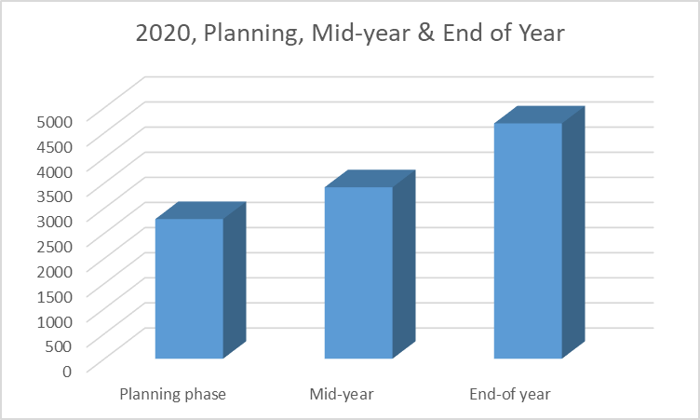
PARTICIPATION IN DEPARTMENTS (NUMBER)

Slide 12
PARTICIPATION RATE IN DEPARTMENTS
2020 Appraisal | No. of Eligible Officers | No. Who Participated | Participation Rate
Planning | 9481 | 2782 | 29%
Mid-Year Review | 9481 | 3415 | 36%
End of year phase | 9481 | 4686 | 49.25%

Slide 13
SUBMISSION REPORTS FOR 2020 END OF YEAR SPAR
MINISTRIES & EXTRA- MINISTERIAL ORGANISATIONS
37/37
CIVIL SERVICE DEPARTMENTS, SECRETARIATS & TRAINING INSTITUTIONS
19/33

Slide 14
EFFECT OF OBSERVATIONS ON OUR WORK
Late submission of report
Delay in the preparation and submission of the service - wide report for timely decision making by OHCS
Unavailability of accurate data for critical decision making by OHCS
Low participation rate from ministries and Departments
Non-compliance with reporting outlines

Slide 15
MEASURES TO IMPROVE IMPLEMENTATION OF SPAR
Close Report
a Week After Deadline
ISSUE LEAGUE TABLE TO M&Ds
Submit List of defaulting M&Ds to CMD, RSIM RTDD for non processing of all HR Facilities
Submit List of Defaulting M&Ds CD/HCS

Slide 16
THE NEXT STEP
E - APPRAISAL

Slide 17
E - STAFF PERFORMANCE APPRAISAL
DEVELOPMENT OF THE SYSTEM IS
ON GOING
TO BE ROLLED OUT NEXT YEAR

Slide 18
E - STAFF PERFORMANCE APPRAISAL
THE SYSTEM WILL OPERATE THE THREE (3) PHASES AND TIMELINES
Planning Phase
Mid-year Phase
End of Year Phase

Slide 19
CHALLENGES THE E-APPRAISAL SYSTEM MAY ADDRESS
NON-COMPLIANCE OF REPORTING FORMAT
REPORT
GENERATION
CALCULATION OF SCORES
LATE SUBMISSION

Slide 20
INTERACTIVE SESSION
SPAR
HOW CAN WE MAKE IT WORK BETTER
?
DPA

Slide 21
THANK YOU

