Slide 1

HUMAN RESOURCE DIRECTORS WORKSHOP
PRESENTATION BY MRS. EUNICE OSAE, DIRECTOR, CAREER MANAGEMENT DIRECTORATE (CMD)

Slide 2
OUTLINE FOR
PRESENTATION
Brief on 2020 Promotions
2021 Virtual Promotion Interviews
Digitization of HR Facilities
Pensions Manual
Other Issues of Concern to CMD

Slide 3
BACKGROUND
In the year 2020, due to the incidence of the Corona Virus Pandemic and the safety protocols put in place to curb the spread of the virus, management of the Office of the Head of Civil Service decided to re-engineer the processes and modes of assessment for promotions

Slide 4
MAJOR REFORMS IN THE
PROMOTION PROCESS
All promotion related documents were to be submitted electronically via a designated email.
All officers in the sub-professional cadre on level 14 and below of the SSSS were to have their documents vetted towards their promotions.
All Assistant Director IIBs and Analogous grades were to have their documents critically examined as a means of assessment for their promotions.
All officers in the sub-professional cadre level 15 and above, Assistant Director IIAs, ADIs and analogous grades were to be invited for virtual interviews to replace the one–on-one interviews.

Slide 5
STATISTICS ON 2020 VIRTUAL
PROMOTION INTERVIEWS
CATEGORY | TOTAL NO. OF OFFICERS
Virtual Interviews | 1707
Critical Review of documents of ADIIBs and analogous grades | 370
Sub-professionals on level 14 and below of the SSSS | 507
Category A | 180
TOTALS | 2764

Slide 6
KEY ISSUES FROM 2020 PROMOTIONS
Late submission of documents
Incomplete documentation from M/Ds
  Secretaries/Technical Officers – GSS Certificate/professional certification
  Drivers - Driver’s License
Appraisal Instruments not properly administered
  Training requirements indicated on the SPAR not linked with Scheme of Service Training
  Targets are not smart.
  Some officers to set their own targets without approval from their Directors
  Sub professionals appraising professionals which is right.
Lack of reliable internet connectivity in some M/Ds
Placement and Utilization of Staff

Slide 7
2021 PROMOTIONS
Six Thousand, Four Hundred and Forty-Nine (6449) eligible officers captured in collated Promotion Registers.
34 Ministries and Extra-Ministerial Organisations and 19 Departments including the Training Institutions have submitted documents on behalf of eligible officers.
4 Ministries and 11 Departments are yet to submit documents.

Slide 8
EXPECTATIONS FROM MINISTRIES & DEPT.
(HR DIRECTORS/OFFICERS AS LAISONS)
Ensure that the complete and accurate documents are submitted
Make available for interviewees logistics such as computers and accessories (Information Technology facilities, Microsoft Teams)
Inform and orient candidates due for promotion on the virtual promotion exercise
Ensure that candidates are set up for the process and alert secretaries to the panels.

Slide 9
DIGITIZATION OF THE PROCESSING OF
HUMAN RESOURCE FACILITIES
For improved service delivery and efficient work processes, the OHCS will roll out an online application system for HR facilities.
To start with, applications for Conversion, Upgrading and Transfers are to be submitted (by HR Directors from M/Ds) via the official OHCS Website.
This mode of application will be extended to cover other HR facilities in the course of the year.

Slide 10
DIGITIZATION OF THE PROCESSING OF
HUMAN RESOURCE FACILITIES (2)
In addition, an Online CV portal will be created for the submission of Curriculum Vitae. This is to standardize the template for CVs and enable the OHCS have access to up-to- date data on staff for informed decision making.
This portal will be accessible to all Civil Service Staff. Officers will also have the chance to update their information as and when needed.

Slide 11
DIGITIZATION OF THE PROCESSING OF
HUMAN RESOURCE FACILITIES (3)
The implementation of these initiatives will be officially communicated to Ministries and Departments

Slide 12
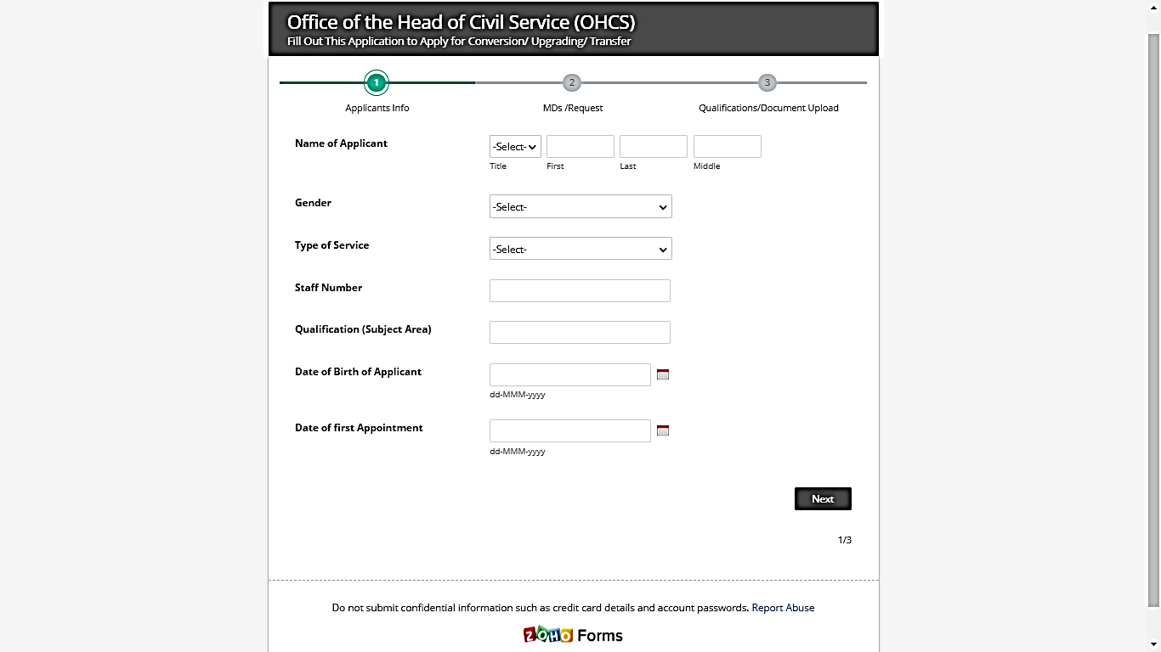
DEMONSTRATION OF ONLINE APPLICATION SYSTEM
Online View

Slide 13
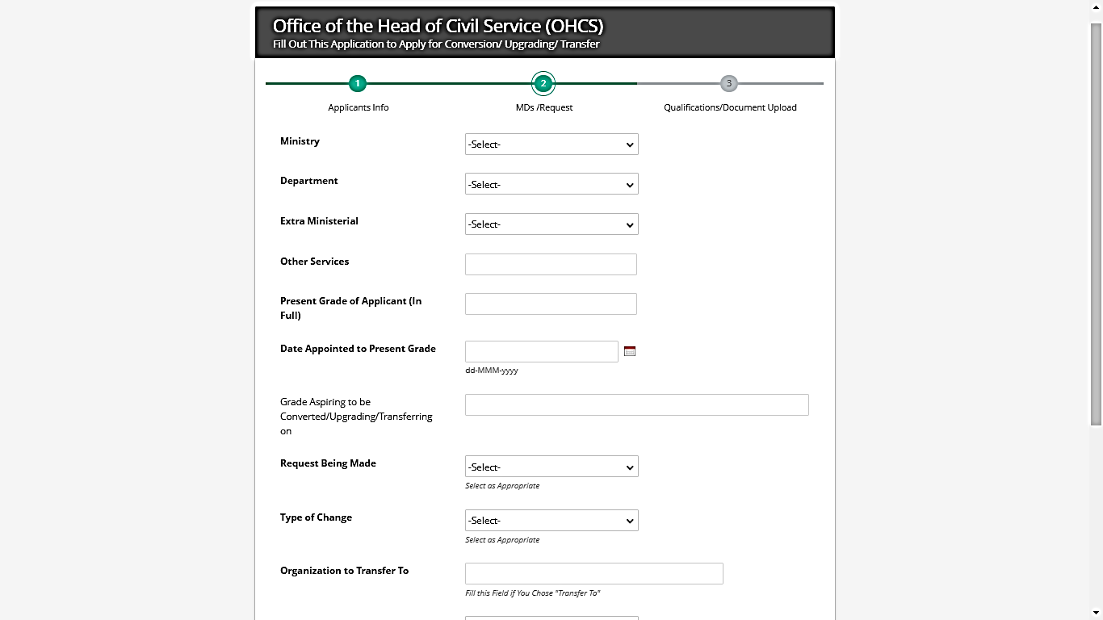
DEMONSTRATION OF ONLINE APPLICATION SYSTEM (2)

Slide 14
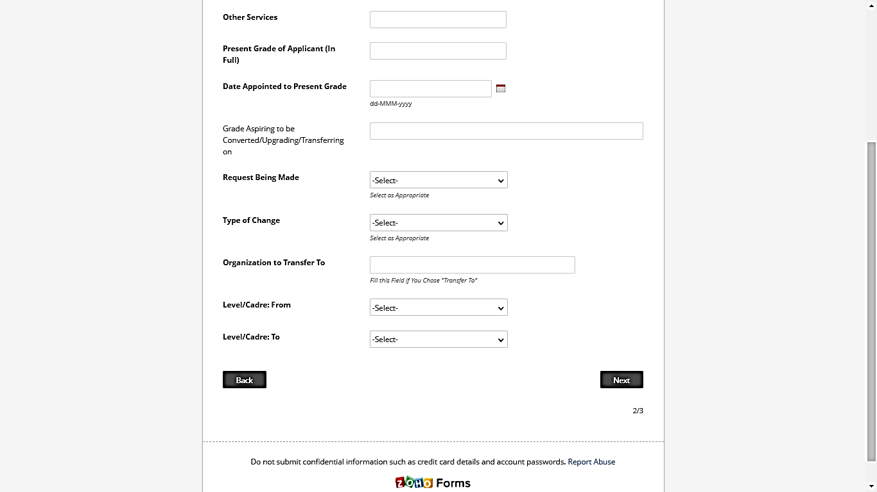
DEMONSTRATION OF ONLINE APPLICATION SYSTEM (2)

Slide 15
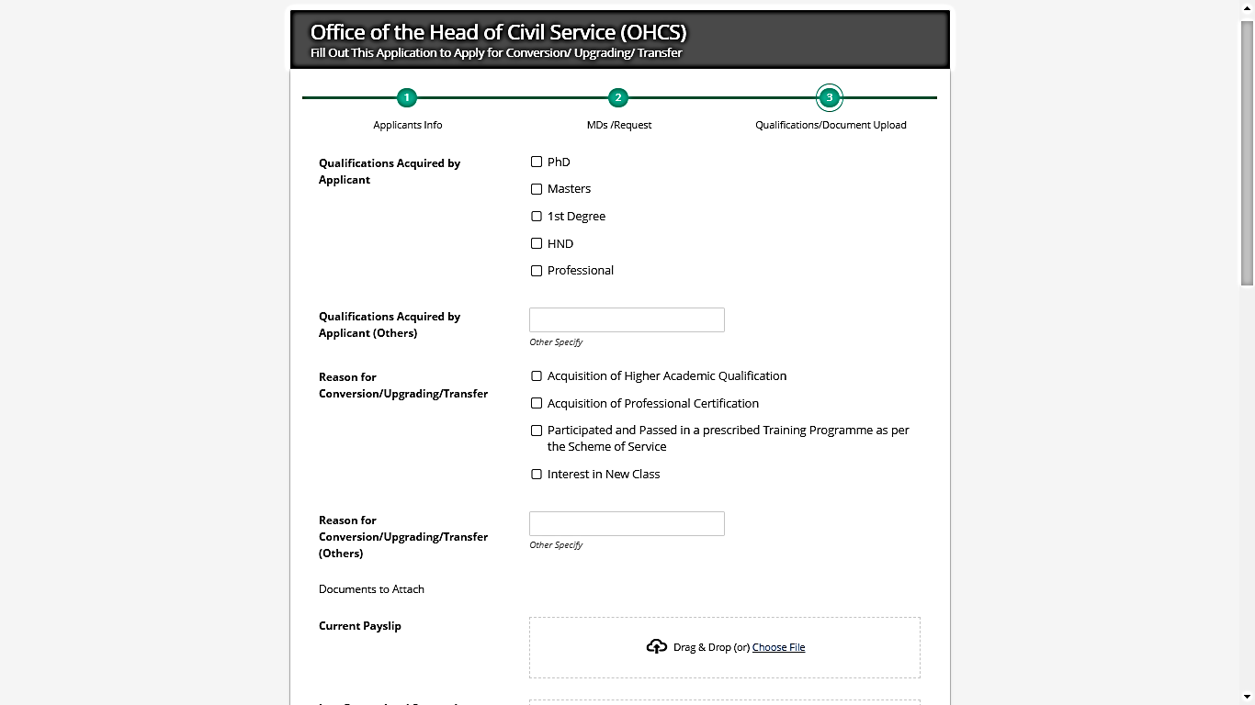
DEMONSTRATION OF ONLINE APPLICATION SYSTEM (3)

Slide 16
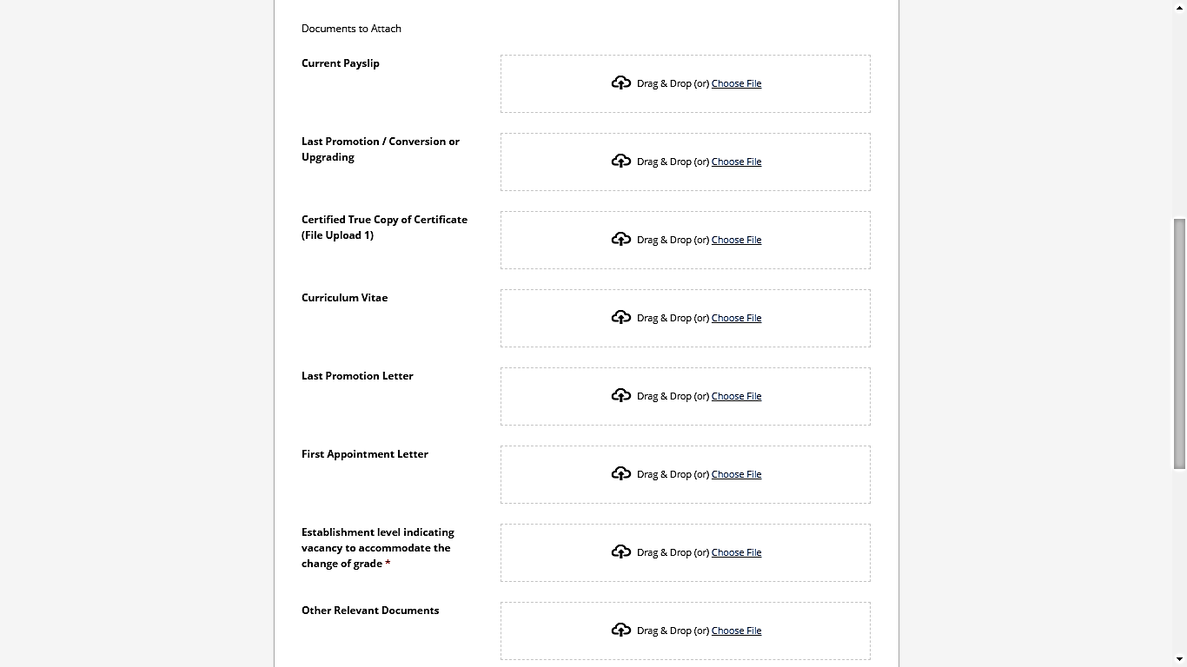
DEMONSTRATION OF ONLINE APPLICATION SYSTEM (3)

Slide 17
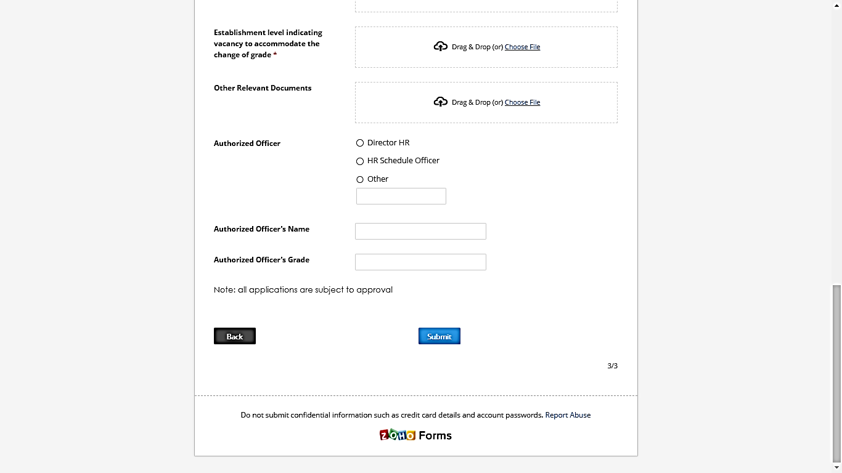
DEMONSTRATION OF ONLINE APPLICATION SYSTEM (3)

Slide 18
PENSIONS MANUAL
Pension schemes in Ghana have evolved over the years and the simplest goal of every pension scheme is to provide stress-free and adequate income for retired Officers so they can have a comfortable life after work
Throughout several pension regimes, thus from the 1946 to 1960s (CAP 30), through to the current National Pensions Act of 2008, Act 766, there have not been significant improvements in the processes for the expeditious receipt of pensions by beneficiaries

Slide 19
PENSIONS MANUAL (2)
The OHCS as part of its activities and also to resolve the administrative bottlenecks and clearly define administrative steps in the processing of pensions, has developed a Pensions Manual.
OBJECTIVES
  Enlighten and clarify the processes and requirements for claiming pension benefits.
  Set up systems to facilitate timely processing within a month after retirement and improve communication channels.

Slide 20
PENSIONS MANUAL (3)
THE THREE (3) TIER PENSION SCHEME PER THE NATIONAL PENSIONS ACT, 2008 (ACT 766)
NO. | TIER TYPE | STATUS | NAME OF MANAGER (TRUSTEES) | (%) DEDUCTION
1 | Tier 1 | Mandatory, Basic Social Security Scheme | Social Security and National Insurance Trust (SSNIT) | 13.5
2 | Tier 2 | Mandatory, Occupational Scheme | Hedge Pension Trust Fund | 5.0
3 | Tier 3 | Voluntary, Personal Pension Scheme(Pempamsie Fund) | To be Determined by Officer | Up to 16.5%

Slide 21
ADMINISTRATIVE STEPS IN PROCESSING PENSION BENEFIT
PROCESSING OF TIER 1 AT SSNIT (MONTHLY PENSION)
The retiring officer must
  present retirement approval letter to initiate the pension benefit process
  complete a pension application form
  present membership certification or SSNIT Biometric Card
  provide an active bank account that bears his/her name and
  updated list of beneficiaries

Slide 22
ADMINISTRATIVE STEPS IN PROCESSING PENSION BENEFIT (2)
PROCESSING OF TIER 2 AT HEDGE PENSION TRUST (LUMP SUM)
The retiring officer must
  Present a retirement approval letter
  Complete a retirement claim form-Tier 2
  Submit one current passport size photograph
  Provide reliable bank details e.g. cheque leaflet/bank statement
  Submit a current payslip
  Submit a valid National ID Card e.g. Voter’s/Driver’s/Passport)

Slide 23
ADMINISTRATIVE STEPS IN PROCESSING PENSION BENEFIT (3)
Processing Survivor’s Lump Sum (1)
A family member shall report the death of the member to the nearest SSNIT/Hedge Branch with any of the following:
  Completed survivor application (Claim) form
  Confirmation letter from the deceased’s employer
  Letters of administration in the absence of previously listed beneficiaries by the deceased.
  One current passport size photograph of the applicant
  Reliable bank details (cheque leaflet/bank statement)

Slide 24
ADMINISTRATIVE STEPS IN PROCESSING PENSION BENEFIT (3)
Processing Survivor’s Lump Sum (2)
  The death certificate of the deceased.
  The burial permit.
  An obituary
  The survivor must submit a valid national ID Card (Voter’s/Driver’s/Passport) of survivor and that of the deceased.

Slide 25
ROLES AND RESPONSIBILITIES IN PROCESSING PENSION BENEFITS
OHCS
Ensure that Manual is accessible to all Civil Service Staff especially HR Managers
Ensure that all Ministries/Departments have assigned Schedule Officers for the facilitation of pension related issues.

Slide 26
ROLES AND RESPONSIBILITIES IN PROCESSING PENSION BENEFITS (3)
MINISTRIES/DEPARTMENTS
The M/Ds shall establish a pensions desk and provide logistics for the Schedule Officers.
SCHEDULE OFFICER
The Schedule Officer shall:
  Prompt retiring officers one year and send reminders six (6) months prior to effective date of retirement.
  Issue Officers due for retirement with retiring letters three (3) months prior to their effective date of retirement

Slide 27
ROLES AND RESPONSIBILITIES IN PROCESSING PENSION BENEFITS (4)
SCHEDULE OFFICER
The Schedule Officer shall:
  Maintain a communication link between the M/D and the retiring Officer to ensure that associated challenges with pension claims are addressed and benefits paid to the beneficiary within six (6) weeks after the retiring date.
  Submit an annual pension report to the OHCS spelling out the challenges of pension facilitation and the respective mitigating strategies.
  Assist officers to complete Tier 2 and Tier 3 enrolment forms for the personal details and beneficiary details

Slide 28
ROLES AND RESPONSIBILITIES IN PROCESSING PENSION BENEFITS (5)
SSNIT
SSNIT shall:
  Maintain an account for each member and credit the account with all contributions.
  Make available the statement of account to members on annual basis and prompt members due for retirement.
  Pay all pension benefits without delay within one month of retirement upon the basis that all information and documentations are accurate (within 14days on average)
  Keep an updated list of beneficiaries provided by officers

Slide 29
ROLES AND RESPONSIBILITIES IN PROCESSING PENSION BENEFITS (6)
HEDGE PENSIONS TRUST
Hedge shall:
  Organize a pre-pensions workshop annually
  Collate all details of retiring officers on annual basis
  Prompt retiring officers of their retiring date two (2) years prior to their retirement
  Be proactive in calculating benefits in collaboration with Controller and Accountant General’s Department

Slide 30
ROLES AND RESPONSIBILITIES IN PROCESSING PENSION BENEFITS (7)
HEDGE PENSIONS TRUST
Hedge shall:
  Keep an updated list of beneficiaries provided by officers
  Process retirement claims one month upon receipt of claims forms
  Make payment of Pension benefits to properly designated bank account
  Send statements of accounts bi-annually to contributors via sms, emails or any other appropriate medium.

Slide 31
ROLES AND RESPONSIBILITIES IN PROCESSING PENSION BENEFITS (8)
The Controller and Accountant General’s Department (CAGD)
Reference to the Pensions Act 766 section (3) Shall
deduct five and half per centum of the worker’s salary from the salary of every worker in the establishment immediately at the end of the month, a worker’s contribution of an amount equal to / for the period, irrespective of whether or not the salary is actually paid to the worker.
Pay for each month in respect of each worker, an employer’s contribution of an amount equal to thirteen per centum of the worker’s salary during the month

Slide 32
ROLES AND RESPONSIBILITIES IN PROCESSING PENSION BENEFITS (9)
By implication with regards to the Law, CAGD shall on behalf of the Employer (M/Ds):
Remit approved deductions to SSNIT and Hedge Pension Trust
Keep up-to-date data on pension deductions on all public officers
Make available data on contributions of Civil Servant to SSNIT/Hedge Pension Trust when needed.
Submit annual report on pension related issues to the Office of the Head of Civil Service.
Give a two (2) year notification of retirement dates to Officers through the electronic payslip system.

Slide 33
ROLES AND RESPONSIBILITIES IN PROCESSING PENSION BENEFITS (10)
STAFF
Employees are required to:
  maintain and keep up to date statements/documents on their pension contributions.
  update list of beneficiaries at SSNIT/Hedge Pension Trust on yearly basis.
  bi-annually visit SSNIT and Hedge Pension Trust to verify if bio data and financial records are current and up to date.
  submit relevant documents to SSNIT and Hedge Pension Trust three (3) months to effective date of retiring.

Slide 34
ROLES AND RESPONSIBILITIES IN PROCESSING PENSION BENEFITS (11)
STAFF (2)
Employees are required to:
  give feedback to employers after processing retirement claims/ benefits (whether successful or not)
  seek for assistance from the employer (when necessary).
  Access contribution statement from SSNIT on the portal provided at the website www.ssnit.org.gh and
  Access benefit statements from Hedge Pension Trust via www.hedgepensions.com.

Slide 35
OTHER MATTERS OF CONCERN TO
THE CMD
ESTABLISHMENT LEVELS
M/Ds are advised not to wait until the review of their Organisational Manuals to review the establishment LEVELS
Establishment ceilings are to be reviewed when staffing requirements change, there is a change in the mandate of the institution etc.
There should be regular update of Establishment levels to reflect current staffing levels.
Updated establishment levels must be attached to every application for Conversion AND Upgrading.

Slide 36
OTHER MATTERS OF CONCERN TO
THE CMD
Attachments accompanying applications
Forwarding of letters
Dates of letters
Deadlines for submission of documents

Slide 37


