Slide 1

THE GOVERNANCE OF PERI-URBAN LAND CONVERSIONS IN GHANA – A CASE OF THE ADENTAN MUNICIPALITY
PRESENTED TO: THE OFFICE OF THE HEAD OF CIVIL SERVICE (OHCS)
30th MAY, 2022
PRESENTED BY: LORINDA SAWYERR

Slide 2

TABLE OF CONTENT
Background
Introduction
  Problem statement & research objective
  DED analytical framework
  Research gap and research questions
  Methodology
Results and findings
Conclusion
Recommendations
Practical Implications

Slide 3
Background
Ghana is over 50% urbanized (Ghana Statistical Service, 2014) - a perfect reflection of the global and African urbanization.
The rapid growth in urban population is not only evident in the major cities of Accra and Kumasi but also in secondary cities.
Ghanaian cities are expanding with many experiencing urban sprawl
Studies have shown that all the fastest growing districts lie within the peripheries of the city of Accra (Akubia and Bruns, 2019)

Slide 4
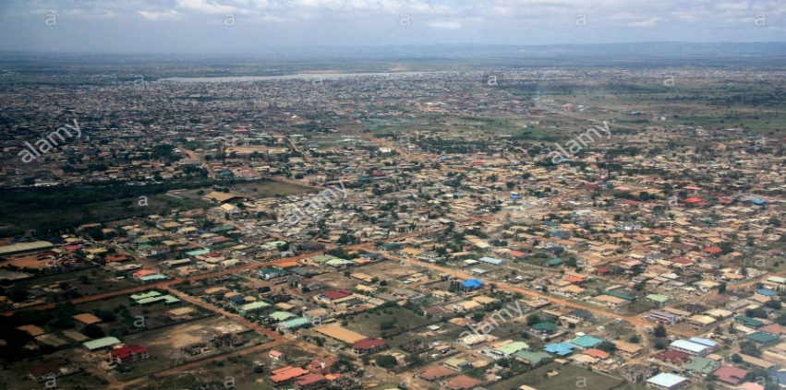
Research Problem
As cities in Ghana are expanding in the face of the fast urbanisation, peri-urban dwellers’ lives do not seem to be improving
Communities seem to have been made worse off while their surrounding areas seem to have be booming in development
Traditional authorities also seem to be enjoying the benefit of land sales to the detriment of the entire land owning community
For this reason, it is essential to find out why the situation is so, hence the need for this research.
Research Objective
This research has been set up as an explorative (qualitative) research to help understand the governance in place in the conversion of peri-urban lands around the growing city of Accra
This is done with emphasis on the extent of the involvement of the peri-urban dwellers within the case study area of Adentan Municipality by adopting the urban governance as Decentralisation, Entrepreneurialism and Democratisation (DED) analytical framework of Franklin Obeng – Odoom.

Slide 5
DED Analytical Framework for Urban Governance
Franklin Obeng-Odoom’s urban governance as DED (decentralization, entrepreneurialism and democratization) has been adopted for this research
In Obeng-Odoom (2012) urban governance in Africa should be analyzed in three stages;
a. sketch the nature of the urban governance in practice in order to account for the context-specific issues.
b. ascertain the consequences of urban governance in terms of improved quality of life.
c. assess how citizens respond the consequences of urban governance.

Slide 6

Identified Research Gap & Research Questions
Research Gap
Not much research has been done into the land governance in peri-urban areas and those that exist concentrate on the various actors and their roles (Nuhu 2018, Resnick 2014)
The Decentralisation, Entrepreneurialism and Democratisation (DED) framework has so far been used in analyzing urban problems Obeng-Odoom (2013), spatial planning (Fuseini, 2016) and market redevelopment (Asante 2020; Asante and Helbrecht, 2019) but not in peri-urban development studies.
Research Questions
To achieve the objective of understanding peri-urban land governance in the Adentan Municipality, the following are research questions that have been posed to guide this research;
To what extent are peri-urban dwellers involved in the governance of peri-urban land conversions?
What are the consequences of the governance process of these land conversions for the local residents of peri-urban areas in Accra?
What strategies are the local residents of peri-urban areas in Accra adopting in response to the consequences of peri-urban land conversions, and its significance for changing governance of peri-urban development?

Slide 7
Methodology
Preliminary search of secondary data on peri-urbanisation
Review of general literature on urban & peri-urban issues
Scope and Process
Further literature review
Specific review of literature on issues of peri-urbanisation in Ghana and the DED analytical framework
Questionnaire preparation and field data collection
10 Municipal Assembly
10 Traditional Authority
30 Peri-Urban Dwellers
Coding of responses
Identifying the issues from the responses
Thematic classification of responses
Further classifying into broader issues
Data Analysis
Results and Findings

Slide 8
Results and Findings
Background of respondents
Expected responses – 50, received responses 48 responses. This represents a response rate therefore was 96%.
Age | No. of Respondents | Percentage (%)
Below 20 years | 1 | 2.1
20-29 years | 7 | 14.6
30-39 years | 10 | 20.8
40-49 years | 17 | 35.4
50 years and more | 13 | 27.1
Total | 48 | 100

Slide 9
Nature of Peri-Urban Land Governance
Level of involvement of actors in peri-urban land conversions
Responses from Municipal Assembly
Responses from Traditional Authority
Responses show very high involvement of Municipal Assembly
Moderate involvement by of the chief
Very low involvement of community members and others
Actor | No Involvement | Low Involvement | Moderate Involvement | High Involvement | Total
Chief |  | 20% | 80% |  | 100%
Elders | 30% | 70% |  |  | 100%
Municipal Assembly |  |  |  | 100% | 100%
Community Members | 30% | 70% |  |  | 100%
Others | 80% | 20% |  |  | 100%

Slide 10
Level of involvement of actors in peri-urban land conversions
Peri-urban residents' perspective of their level of involvement
Some suggested reasons the peri-urban residents gave for their non-involvement were;
Those in charge think we are not qualified and have nothing to offer
It is perceived that the involvement of the chief means we are also involved
Those in charge do not care about us
All peri-urban respondents also made it known that there was no Civil Society involvement in land conversions – 100%

Slide 11
Responses from Municipal Assembly for Land uses for development plans
It was found that there was no policy on the percentages for land uses on the development plans but what pertains currently is 70% for residential uses, 20% for commercial uses and 10% for other uses
This shows that the need of land for agricultural purposes are not considered much
6 of the Municipal Assembly’s respondent made statements that the traditional authority sometimes ignore plans and grant leases to people for residential purposes in areas meant for the other uses.
Thus tends to increase the land use percentage for residential purposes and worsens the plight of the peri-urban dwellers

Slide 12
Consequences of Peri-urban Land Governance
                The traditional authority respondents gave diverse responses as to how the monetary benefit was apportioned
                Chief and his elders take all – 3 respondents
                Shared between the traditional council and the community – 3 respondents
                Shared among the chiefs, the community and the Municipal Assembly – 2 respondents
                80% of the peri-urban dwellers said all the money went to the chief while 20% said the money goes to the chief and the elders
                These benefits together with other Municipal funds are used to provide infrastructure and other services to the peri-urban areas.
                In spite of these benefits, 70% of the Municipal Assembly’s respondents stated that the predominant effect of the non – involvement of the community members in the land conversion is that the implementation of the planning scheme becomes difficult.

Slide 13
Consequences of land conversions on livelihoods of residents
Opinion of the indigenous peri-urban dwellers on the effect of their non-involvement in land conversions
4 out of the 5 respondents who answered that the effect is seen in the non-peaceful development for urban residents were people with tertiary education.
24 out of 25 of the respondents who stated the effect of their non-involvement was loss of agricultural livelihood had lower educational qualification.
Predominant occupation of residents
Residents resorted to other means of livelihoods like trading and working in growing construction industry in their community.
Another finding the buttresses this assertion was that, most of the respondents over 50 years stated they were unemployed but they were quick to add that they used to be farmers – 8 respondents out of 12.

Slide 14
Consequences on income levels of peri-urban dwellers
Income of residents generally improved with the on-going land conversions.
This was attributed to jobs they got in trading and construction which fetches them better income.
6 respondents had their incomes staying within the GH¢500 and below bracket. these respondents were over the ages of 50 years.
5 respondents had no change in income.
These respondents had tertiary education levels and were working outside the community hence, their jobs and incomes were not affected.
Consequences on community life
Further analysis show that majority of respondents who opted for the effect being the youth getting involved in social vices were over 50 years and above
On the other hand, all respondents between the ages of 20-39 years, opted for loss of community identity – where they see a lot of segregation as a result of the on-going land conversions.
This goes to show that different age groups see the effect of land conversions on community life differently.

Slide 15
Strategies that peri-urban dwellers use
The means used by most residents was to avoid communal activities
All respondents who resorted to the use of media had tertiary education
All respondents who resorted to petitioning public figures were females over 50 years
All respondents who used protests and demonstration were youth between 20-49years
The differences show that different age groups and educational qualifications resorted to different strategies

Slide 16

Conclusion
Good governance is said to include; decentralisation, improving civil rights and minimising inequities in societies.
All these were not seen to be at play in peri-urban land conversions in the Adentan Municipality
Findings showed clearly that there was no civil society involvement in peri-urban land governance in the Adentan Municipality.

Slide 17
Conclusion
Also inequality in peri-urban land governance in the Adentan Municipality can be seen in;
how the local peri-urban dwellers are minimally involved in the land conversions and even when they are involved it is the elderly males and not the other groups of residents.
the allocation of land uses where more land is allocated to residential and commercial uses against other uses including agricultural uses which is the main livelihood of these indigenous peri-urban dwellers.
the sharing of monetary benefits from land sales, majority of which goes to the chief and his elders.

Slide 18
Conclusion
Shortfalls in the peri-urban land governance have brought untoward hardships to the indigenous peri-urban dweller including;
Loss of livelihoods
Loss of communal life
The upsurge of social vices among the youth.
Increased living costs even though incomes have also increased
There was also a rippling effect on the work and revenue of the Municipal Assembly, where revenues were lost due to certain actions from the youth.
There is therefore the need for an all inclusive governance system in peri-urban land conversions in the city of Accra.

Slide 19
Recommendations
To help achieve good governance is peri-urban land management, this research recommended the following;
Firstly, there should be more inclusion of other actors in peri-urban land governance – women, youth and civil society and not only elderly men in the community.
The second is that a policy on land use plans should be developed for use by Municipal Planners.
Thirdly, there should be the use of the monetary gains from land sales for development of the indigenous community.

Slide 20
PRACTICAL IMPLICATIONS
Firstly, I have gained competency in the use of the Geographic Information System (GIS) software known as ArcGIS in solving daily spatial problems most of which are land related.
The OASL is currently undertaking a rollout of an APP as part of its digitalisation process. This App relies on spatial data and I believe my knowledge will really help in the digitalisation activities especially with the data collection and report analysis.
Again, I have gained knowledge in data analysis for research writing and policy development.
As part of our activities, the OASL undertakes research into stool land issues and I believe my knowledge is this area will help in such studies.
My studies in theories of new town development and other related subjects have built my knowledge on how Ghana as a developing country can develop new towns which will suit the needs of the people.
One area worthy of mention is the way public participation can be undertaken and how land adjustment can be done especially in already built up areas of urban areas.

Slide 21

THANK YOU FOR YOUR ATTENTION

