Slide 1
BACK TO OFFICE PRESENTATION KNOWLEDGE SHARING AFTER FURTHER STUDIES/ COURSE FOR STAFF OF THE CIVIL SERVICE
BY
Atsu D. AKPAKLI

Slide 2
Part One-Outline
Self Introduction
GDP of Ghana and Korea in Perspective
Overview of the Course
Broad Goals and Objectives of the Programme
Key Subjects and Learning Areas

Slide 3
Self Introduction
Name: Atsu Divine Akpakli
Educational Background:
Master’s in Infrastructure Planning and Development from International School of Urban Sciences, University of Seoul-Republic of Korea.
Bachelor of Management Studies (BMS -Major in Business Management and Minor in Economic) from University of Cape Coast.
Post Graduate Diploma in Business Administration (PGDBA) from GIMPA, Achimota-Accra.
Association of Chartered Certified Accountant (ACCA) Part One.
Certificate in Policies, Basics and Practices in Public-Private Partnership, Hammersmith Consults, Dubai and
Seminar Certificate in Traffic Planning and Management from Institute of Commence and Transportation, Fujian Province, Republic of China.

Slide 4
Self Introduction Cont’d.
Current Grade: Assistant Director I
Office of the Head of Civil Service (OHCS)-Policy, Budgeting, Monitoring and Evaluation Directorate (PBMED)
A Team Lead for the preparation of Staff Performance Appraisal Composite Report (service-wide).
A Member of a Team responsible for the verification of data in the Self-assessment reports submitted to OHCS on Chief Directors Performance Agreements.
Prior to the above roles, I was with Ministry of Transport from February, 2013.
I am eternally grateful to my former Boss and CD all of MOT for their support.
I also worked with Ghana Audit Service between January 2010 to January, 2013.

Slide 5
GDP of Ghana and Korea in Perspective
GDP: Primary indicator of macroeconomic performance of countries | 1960 | 1970 | 2020 | Difference in the GDPs
Ghana’s Gross Domestic Product per capita (GDP per capita) | $183 (Dif. $ 25) | $254 | $2,329 | $ 29,160
Korea’s Gross Domestic Product per capita GDP per capita | $158 | $279 (Dif. $25) | $31,489
Ghana GDP Per Capita 1960-2022 | MacroTrends
South Korea GDP Per Capita 1960-2022 | MacroTrends

Slide 6
Overview Of The Course
Name of program: Global Infrastructure Development Scholarship Programme
Degree: Master of Infrastructure Planning and Development (MIPD)
Course duration: 1st August 2019 to 31st December 2020.

Slide 7
Broad Goals and Objectives of the Programme
Provide theoretical as well as practical education, field visits and internship opportunities that enable government officials from Korea’s partner countries to formulate a long-term national comprehensive plan for territory development.
Develop participants’ faculty of embracing a wide range of urban and regional development plans as well as projects that encompass infrastructure planning, material procurement and construction.

Slide 8
Broad Goals and Objectives of the Program
Strengthen participants' understanding on Korea’s development experiences and enable participants to contribute to the sustainable development of their respective countries with the knowledge acquired in Korea.
Provide program participants with opportunities to develop cooperative relationships and personal networks with scholars, professionals, and government officials worldwide.
With the above-stated objectives, students were requested to learn theories, concepts, principles, and practical cases of the following key subject and learning areas.

Slide 9
Key Subjects And The Learning Areas
No. | Key Subjects | Key Learning Areas
1. | Public Investment Management | This course provides graduate students with an opportunity to gain or enhance knowledge about how public investment management (PIM) can be designed to improve efficiency of government spending.
2. | Public-Private Partnership | The learning areas include funding sources for infrastructure investment, infrastructure challenges, and how PPP can help, how PPPs are financed, legal and institutional framework, and PPP processes and institutional responsibilities.
3. | Urban Transportation Planning | The key learning include basic concepts related to transportation and the importance of transportation in the economy, the relationship between transportation and urban planning, major transportation plans of Korea to understand the effects of plans, the study of mass transit, the principles of user choices, study taxi and parking policy, understand traffic accident and its impact on society, including characteristics of human behaviour to improve safety and policy implementation.

Slide 10
KEY SUBJECTS AND THE LEARNING AREAS
No. | Key Subjects | Key Learning Areas
4. | Urban Infrastructure Development | The learning areas include understanding of infrastructure systems within the context of the organizations responsible for the management and development of these facilities, the economic and legal conditions that regulate the systems as well as planning, operation and management of these systems.
5. | Construction Project Management | An opportunity to learn principles and practice of construction management theory, project feasibility processes, pre-construction, delivery methods, pricing systems, procurement, project administration, and project closeout.
6. | Global Network Seminar (GNS) | This course enhanced students’ knowledge in a selected topic area relating to construction or urban development. It has strengthened and improved the ability to work in groups and in a global setting. It also helped improved communication and presentation skills

Slide 11
KEY SUBJECTS AND THE LEARNING AREAS
No. | Key Subjects | Key Learning Areas
7. | Climate Change | The learning areas included but not limited to land ethic and sustainable development, urbanization and climate change, mitigation and adaptation, sustainable land use and urban design, sustainable transportation, sustainable energy and material use, sustainable architecture and building, case study presentations, sustainable water use and management, green Infrastructure, natural hazards and resilient cities, governance of climate change adaptation.
8. | Regional Development | The learning areas include the process of planning and (re)development in urban areas and the analysis of their impact on the physical, social, and economic environment. The nature and causes of economic decline, social exclusion, and environmental dereliction in urban areas. The different approaches taken to secure urban (re)development and critiques of the approaches.
9. | Thesis Writing | Thesis writing was an integral part of receiving a master’s degree in University of Seoul. Graduates students were required to submit policy research topics in the application process. After writing Thesis qualification exams, I selected my final topic in the area of road safety.

Slide 12
Part Two:Thesis Presentation Outline
Background and Introduction
Literature Review
Methodology and Data Analysis
Discussion and Results & Findings
Conclusion and Recommendations
Challenges
Programme Impact and Lesson Learnt

Slide 13
Thesis Topic An analysis of the major factors contributing to traffic accidents in Ghana: Mining road traffic accident data to improve safety

Slide 14
1. Background and Introduction
What is road safety?
The concept of road safety deals with road traffic accident prevention in terms of persons being killed and or seriously injured.
Ducalingo.com referred to it as “methods and measures for lessening the potential risk of a person using the road network being killed or seriously injured
What is traffic accident?
A traffic accident was defined as “a traffic collision, or crash occurs when a vehicle collides with another vehicle, pedestrian, animal, road barrier”, and or “any stationary obstruction such as tree or utility poles” Mohammed et al, (2019).

Slide 15
1. Background and Introduction
Over 1.35 million deaths and greater number of serious injuries are recorded yearly across the world (WHO, 2018).
The findings further posited that 93% of the crashes came from developing countries.
Traffic collisions have been a major source of social and economic problems (Ali et al.,2019).
In the last decade, Ghana recorded more than 2,000 persons being killed annually from road crashes.

Slide 16
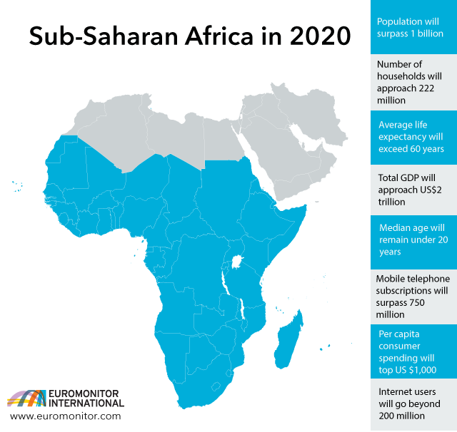
1. Background and Introduction cont’d.
The cost is estimated to be 3% of GDP for most developing countries.
Sub-Saharan Africa is noted to be “the global capital for traffic deaths”
Limited progress in reducing the number of deaths, (WHOs, 2018).
https://www.who.int/news-room/fact-sheets/detail/road-traffic-injuries

Slide 17
2. Literature Review
Folla et al., (2019) investigated road traffic risks in Africa, using VKP-Vehicle Killing Potential i.e traffic deaths per 1,000 vehicles as an indicator.
The results indicated that countries in the North and south have lower VKP than countries in West, Central, and East Africa.

Slide 18
2. Literature Review
Ackaah & Adonteng (2011) investigated causes of road traffic accidents (RTAs) in Ghana they attributed the causes to fatigue driving, excessive speeding, wrongful overtaking, non-maintenance of vehicles, poor nature of roads, non-use of pedestrian crossing, and crossing without paying attention to traffic on the road.
In 2019, during the Meet-The-Press Series by the Ministry of Transport, it was noted that most of the recent RTAs in the country were because of road-user indiscipline, (among vehicle drivers and cyclists ), speeding above the posted speed limit, wrongful overtaking, pedestrian jail-walking, and disregard for traffic signals at intersections, particularly riders of motorcycles, (MoT, 2019)

Slide 19
2. Literature Review cont’d
Krishnaveni and Hemalatha, (2011), used artificial intelligence tools to analyze 14,576 data collected for the year 2008.
The paper concluded that among the tools used, Random Forest performed better than Naïve Bayes, J48, AdaBoostM1, and PART for predicting classification accuracy.

Slide 20
2. Literature Review cont’d
Yang and Kim, (2003) conducted a study on road traffic crashes in Korea and found out that crashes increased in eightfolds, from 37,000 in 1970 to 290,481 in 2000.
Deaths for the period also rose in three-folds and injuries increased in ten-folds.
Consequently, Korea implemented 21 measures to enforced penalties against risky driving behaviors e.g., drunk driving and speeding), installed traffic monitoring cameras, provided financial rewards to whoever reported traffic violation, introduced road safety evaluation system, corrected, and maintained accident blackspots in existing roads, and carried out safety education programs. The measures helped averted traffic accidents significantly.

Slide 21
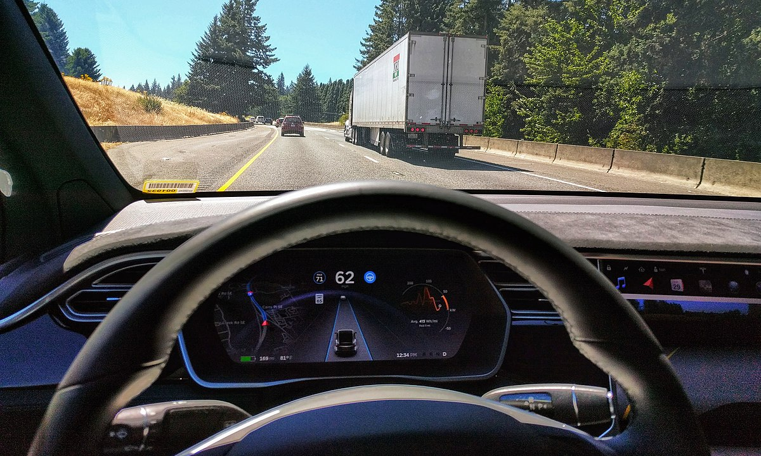
2. Literature Review cont’d.
Similarly, Hong et all, (2020) employed the apriori association rules to find out crash-risk factors involving the transportation of hazardous materials on expressways in Korea.
The results indicated that male drivers conveying hazardous materials with tank-lorry and cargo trucks during daytime, under a clear weather condition, on the mainline segments were likely to get involved in an accident against a shoulder guardrail or get involved in single-vehicle crashes.

Slide 22
2. Literature Review cont’d.
Research Gap: Many authors adopted the traditional methodologies to investigate and examine the causes of traffic accidents, however, the issues of safety are still persistently precarious.
Using an artificial intelligence tool, the Association Mining Rule (AMR) to predict and reduce RTAs is a significant contribution to road safety research in Africa, particularly Ghana.

Slide 23
2. Literature Review cont’d.
Road transportation is the heavily used mode, and it carries more than 95% of passengers and freight in Ghana.
As part of its vision, transportation should be safe, secure, affordable, and accessible in Ghana (National Transport Policy, 2008).
Regrettably, by the end of 2016, only 41% of the road network was in good condition, 33% was in fair condition and 26% was in poor condition

Slide 24
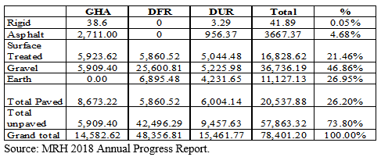
2. Literature Review cont’d.
.
Meanwhile, according to the draft Ghana Infrastructure Plan, the size of the network will be expanded from the 2016 level of 78,401km to about 253,000km in the year 2047 of which 77% should be paved.
As of 2018, only 26.20% of the total network size was paved.
South Korea’s road network size in 2018 was 110,714km of which 84% were paved.
List of countries by road network size - Wikipedia

Slide 25
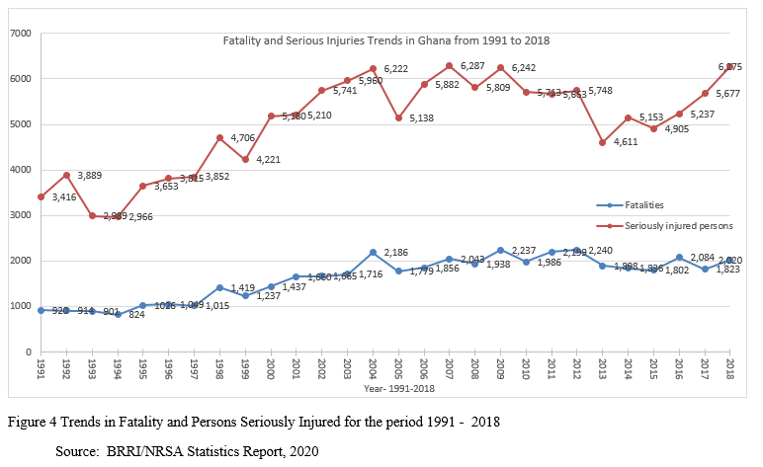
2. Literature Review cont’d.
The trends of fatalities and serious injuries from 1991 to 2018 indicate that a total of 279,420 crashes occurred involving a total number of 439,107 vehicles resulting in the deaths of 45,710 persons and the number of persons seriously injured being 140,160 for the period (BRRI, 2020)

Slide 26
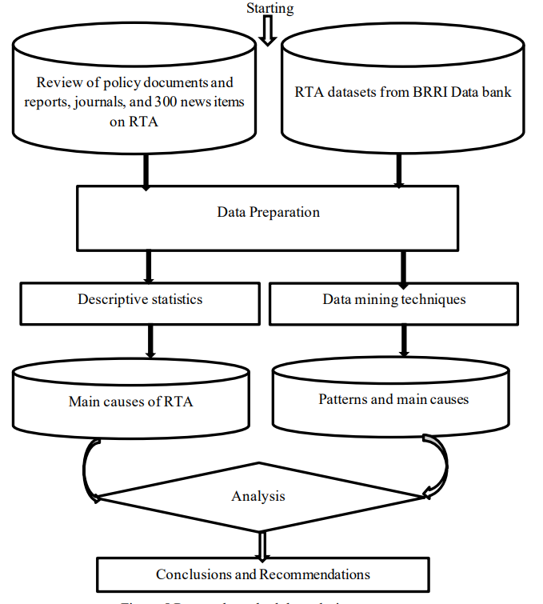
3.0 Research Methodology

Slide 27
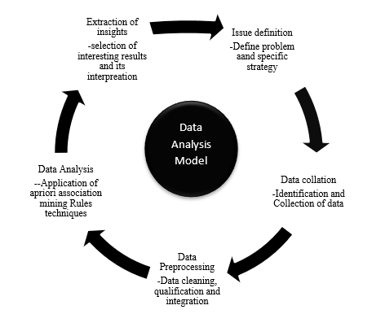
3. Methodology cont’d.
For this study, a total of 4,395 datasets with 31 attributes were analyzed through Association rule mining

Slide 28
4. Discussions, Results, & Findings cont’d.
The trend in fatalities shows that there was about 119.57% increase in the number of deaths in 2018 on the figure recorded in 1991
While the number of persons seriously injured increased by about 4,003%.
Similarly, fatalities per 100 crashes rose from 11.0 per 100 crashes in 1991 to about 20.5 per 100 crashes in 2018.
Fatalities per 100,000 population recorded in 2018 was 7.11 compared with 6.21 recorded in 1991.
Interestingly, there was a significant reduction in fatalities per 10,000 vehicles recorded in 1991 which was 69.67 compared with 7.54 figures recorded in 2018.

Slide 29
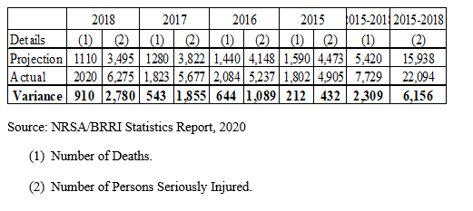
4. Discussions, Results, & Findings cont’d.
Actual and Targets for Deaths and Serious Injuries for 2015 - 2018
While NRSA projected to reduce crashes from 2,199 deaths in 2011 to 1,590 in 2015
The fatalities for that year (2015) were 1,802, representing an adverse variance of 212 deaths.
The number of seriously injured persons increased by 432 more cases comparing planned target of 4,473 with the actual figure of 4,905 persons seriously injured in the year 2015.

Slide 30
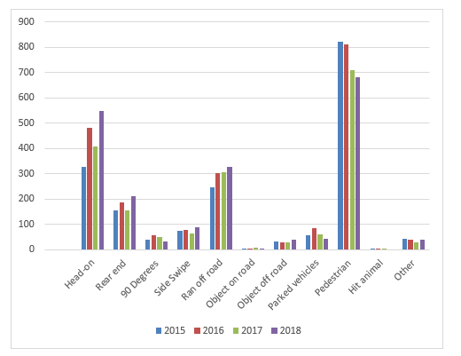
4. Discussions, Results, & Findings cont’d.
I found out that some attributes such as collision type; head-on, vehicle run off, and pedestrian knockdown as critical factors influencing traffic accident in Ghana.
Case study below:
Collision Type Resulting in Injuries

Slide 31
4. Discussions, Results, & Findings cont’d
The case study covered 3 years from 2016 to 2018 in the Ashanti Region.
Ashanti Region is the largest region among the 16 administrative regions of Ghana with a land surface area of 24,390km2.
The region has estimated population of 5.93 million people in 2020 according to the 2010 Census data

Slide 32
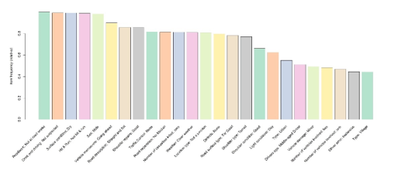
4. Discussions, Results, & Findings cont’d.
The top 25 most frequent occurring items
The results indicate that five (5) topmost items-{roadworks: not at roadworks}, {drink driving: drink driving not suspected}, {surface condition: dry}, {hit & ran: not hit and ran}, {sex: male}.

Slide 33
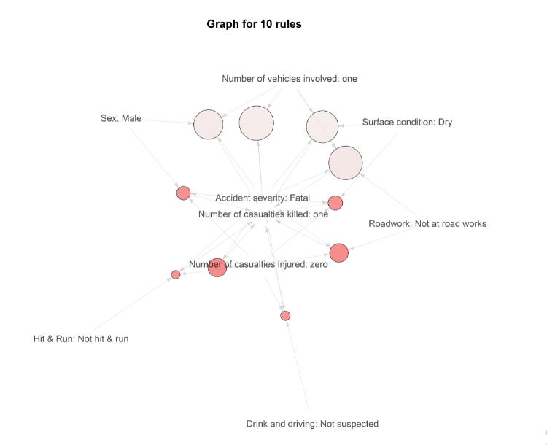
4. Discussions, Results, & Findings cont’d.

Slide 34
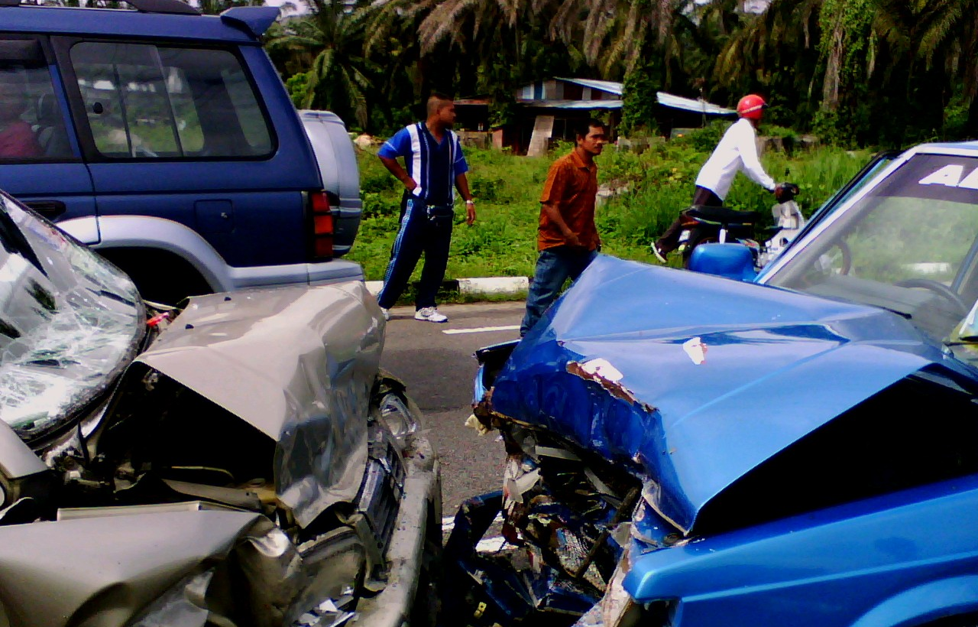
4. Discussions, Results, & Findings cont’d.
The results showed that accidents in the region were largely associated with male drivers, driving carelessly under good weather condition; on dry road segments, where there were no on-going roadworks.
Head-on collision happened mostly at the sessions where there were no median separators, and the shoulders of those roads were not tarred.

Slide 35
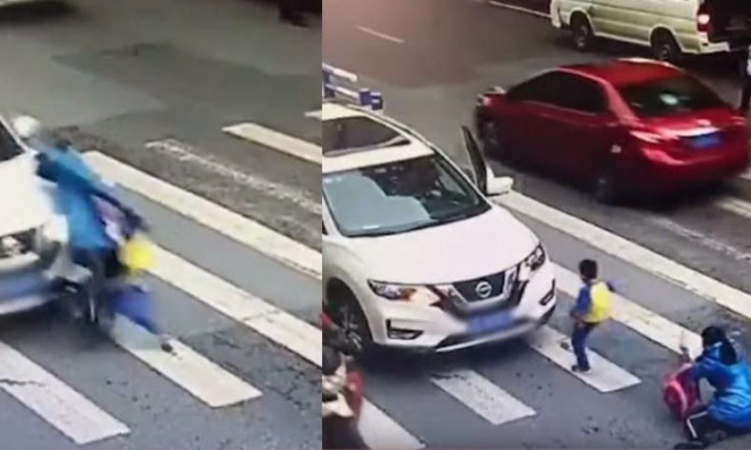
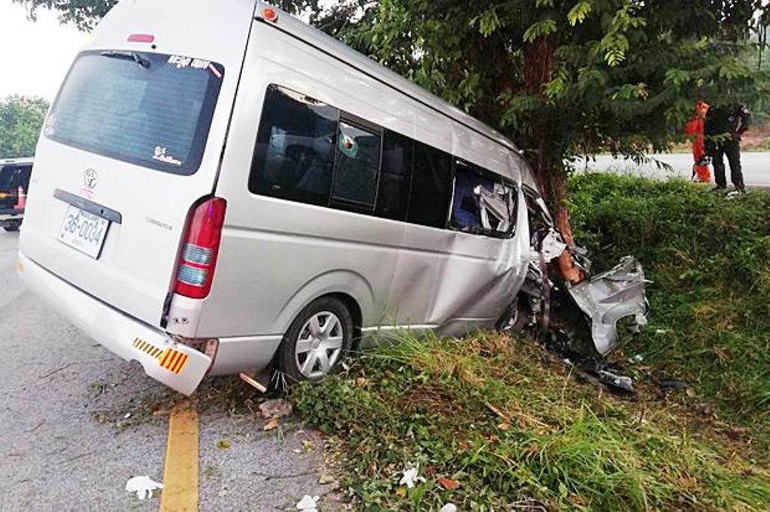
4. Discussions, Results, & Findings cont’d.
Single-vehicle crashes mostly involved pedestrian knockdowns resulting in serious injuries and fatalities.
Most notably, accidents emanating from vehicle ran-off road were largely associated with middled-aged drivers between ages of 31 – 45 years.

Slide 36
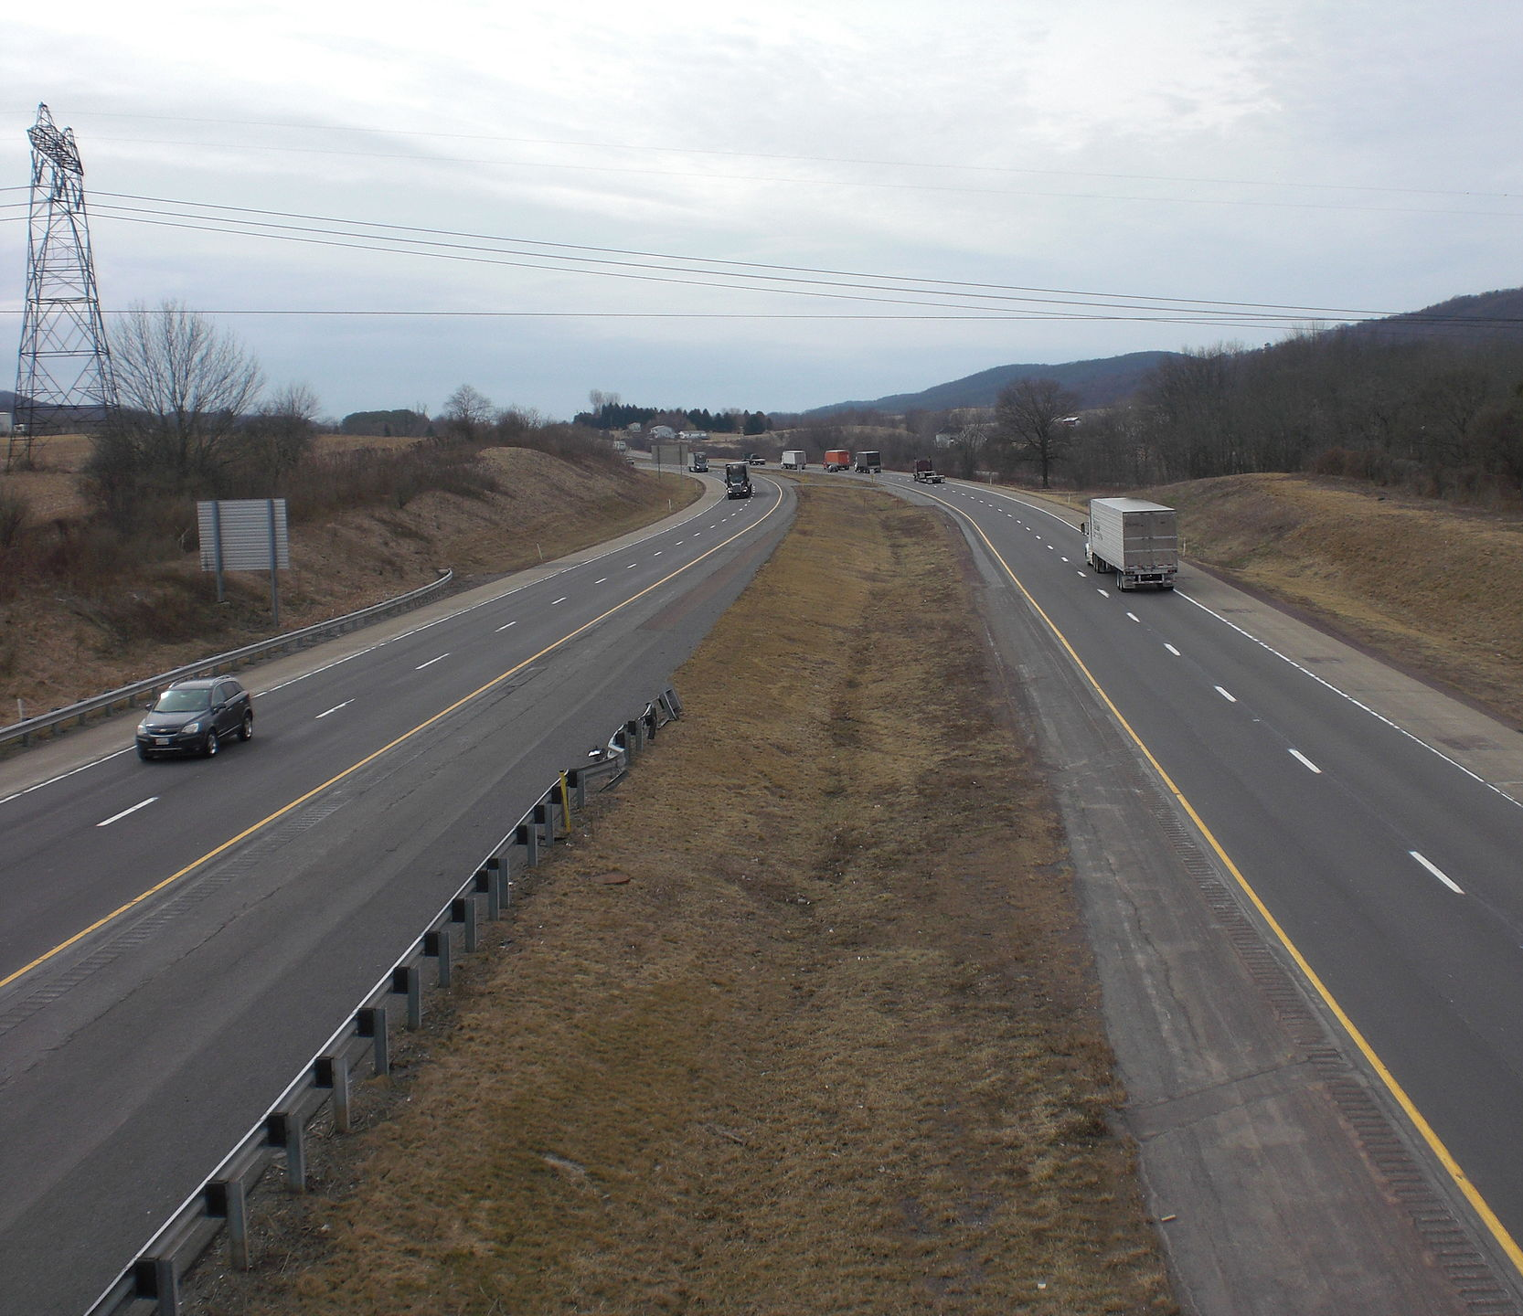
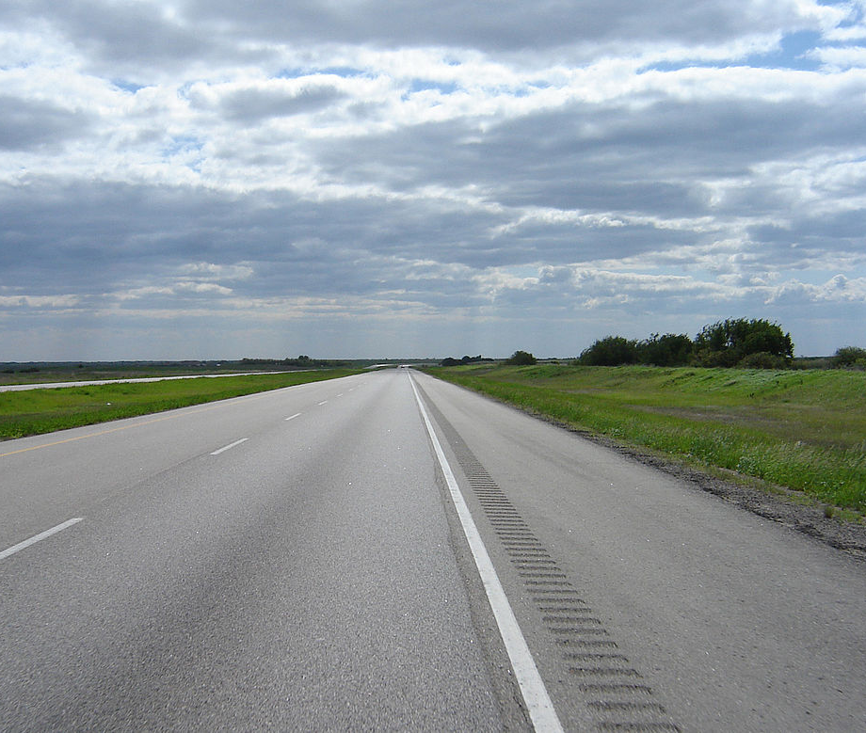
Conclusion & Recommendations
Pedestrian facilities should be incorporated in the design and construction of roads, median separators should be installed, untarred road shoulders should be maintained.
Predominantly, male drivers drove with excessive speeds on these roads in the region.

Slide 37
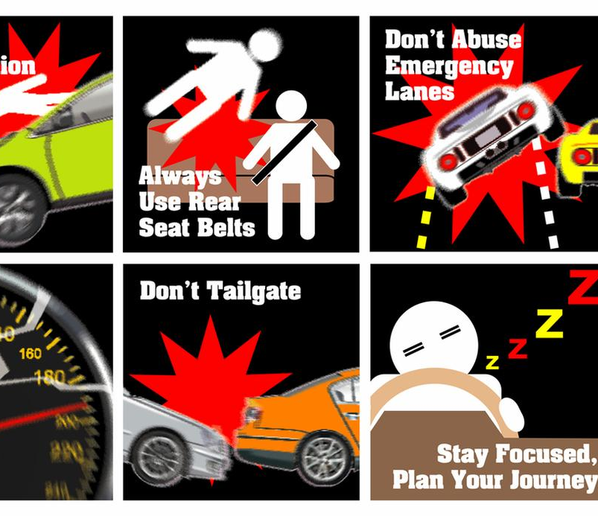
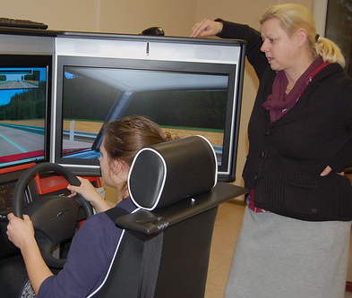
Conclusion & Recommendations
An effective safety awareness campaign should be vigorously pursued, including wearing of seat belts and wearing of crash helmets.
Training and re-retaining of drivers on defensive driving should be the topmost priority targeting drivers between the age of 31 to 45 years.

Slide 38
Conclusion & Recommendations
The sector should expedite actions on the implementation of policies that encourage women to go into driving of public vehicles

Slide 39
Conclusion & Recommendations
As noted early on, my thesis research area is on road safety. I believe the recommendation in the thesis when implemented would support in reducing traffic fatalities and serious injuries on the roads in the country
Additionally, I am thankful to the Head of the Civil Service when he encouraged civil servants to learn and acquire higher degrees including PhDs as this will go a long way to support government formulate and implement policies for the benefits of the citizens
In this regard, I urge the Office of the Head of Civil Service to team-up with other sponsored educational programmes in Korea and other countries to enable more Civil Servants take advantage of the opportunities available
Korea relies on the rich human resource at their disposal for its economic transformation and rapid development

Slide 40
Challenges
Impact on Korea Language Ability
Although all courses were taught in English Language, an indirect benefit of the program was the opportunity to learn basic Korean.
To learn a foreign language at a relatively older age comes with some challenges.
This is because it was established that learning different languages at tender ages yields better results that learning same at relatively older age.
Covid-19 Restrictions
Impact of the Covid-19 measures restricted students from going to many more project sites and undertake other internship opportunities available.

Slide 41
Programme Impact And Lesson Learnt
Impact on Korea Language Ability
Although all courses were taught in English Language, an indirect benefit of the programme was the opportunity to learn basic Korean. To learn a foreign language at a relatively older age comes with some challenges.
Impact of Korea Culture
At the centre of the language acquisition is the culture of the people of Korea. Koreans are largely homogenous. They believe in the policies of their Government. Except for political reasons, no one goes against public policies, and they are largely compliant with the rules and regulations put in place by the authorities. For example, in the face of the COVID-19 pandemic, every Korean complies with government directives per any level of social distancing measures put in place.

Slide 42
Programme Impact and Lesson Learnt
Personal and Professional Impact of the Program
In terms of the level of satisfaction with respect to the study, the programme exceeded my expectation. I was satisfied because the programme met overall goal of equipping me with enormous amount of theories, practices, principles, and hand-on research which were integral part of the programme delivery. I was also satisfied with level of rigor in the thesis writing process.
Enhanced International Capability
The Master of infrastructure planning and development program enhanced students’ international capabilities, and it included a combination “deepened cross-cultural understanding”, knowledge of another country’s system and practices. The MIPD program gives an international career outlook to the students.
Through the courses, a lot of perspectives were shared on economic policies implemented across regional blocks in Asia, Europe, the West, and Africa, etcetera

Slide 43
Programme Impact and Lesson Learnt
Thus, I began to bring to the fore the new acquired skills, knowledge, and experience on my duties and responsibilities at workplace.
Although I believe I have enhanced my ability to perform any given task without much difficulty, learning has no end to it.
With my current capacity, I am able to learn and handle a given tasks more effectively and efficiently.
As noted early on, my thesis research area is on road safety. I believe the recommendations in the thesis when implemented would support in reducing traffic fatalities and serious injuries on Ghana’s roads.

Slide 44
Thank You
Comments, Suggestions & Questions

