Slide 1
KNOWLEDGE SHARING FORUM
PRESENTED BY: KENNETH MILLS
DEGREE: MASTER OF ECONOMICS (INTERNATIONAL FINANCE AND INVESTMENT)
SCHOOL: UNIVERSITY OF INTERNATIONAL BUSINESS AND ECONOMICS (UIBE)
GRADE: SENIOR INTERNAL AUDITOR

Slide 2
PRESENTATION OUTLINE
PROGRAM BACKGROUND
& INTRODUCTION
DETAILS OF COURSE
IMPACT
RECOMMENDATIONS
APPRECIATION

Slide 3
MOFCOM Scholarship is set up by Ministry of Commerce of People's Republic of China.
Further strengthen the communication and cooperation between China and other countries (Ghana)
Develop talents for developing countries.
TUITION
ACCOMODATION
LIVING ALLOWANCE
MEDICAL INSURANCE
AIR TICKET

Slide 4
UIBE
ECONOMICS
FINANCE
INTERNATIONAL TRADE
LOCATED IN BEIJING
LEADING UNIVERSITY IN ECONOMICS, FINANCE & TRADE IN CHINA

Slide 5
MSc INTERNATIONAL FINANCE AND INVESTMENT?
MIFI
YOUTH OF EXCELLENCE SCHEME
(YES CHINA)
ONE BELT ONE ROAD PROJECT
PROMOTE REGIONAL ECONOMIC INTEGRATION
DEVELOP GLOBAL FINANCIAL TALENT
TWO(2) YEARS RESEARCH BASED PROGRAM
SENIOR GOVERNMENT OFFICIAL

Slide 6
DETAILS OF THE COURSE
INTERNATIONAL FINANCE
INTERNATIONAL ECONOMIC COOPERATION
INTERNATIONAL TRADE
ECONOMETRICS
INVESTMENT
FINANCIAL MARKETS
RISK MANAGEMENT
CHINESE
CORPORATE FINANCE
INTERNATIONAL FINANCIAL MANAGEMENT

Slide 7
DETAILS OF THE COURSE
TRAINING MODULES
Class Teaching | Lectures, case studies, speeches, tutoring and other forms of flexible and diverse teaching methods
Business Visits | Chinese financial supervision departments, commercial financial institutions, economic development zones, E-commerce enterprises and internet financial businesses
Cultural Experience | In addition to a monthly trip to rural suburbs of Beijing, MIF program also plans arrangements and study tours for participants to go out of the capital to experience Chinese culture.

Slide 8
OUTCOMES AND IMPACTS
ACADEMIC ACHIEVEMENT
ACADEMIC REQUIREMENT |  | STATUS
1. | Completed all course modules and thesis | Completed
2. | Submitted and completed thesis defence | Completed
3. | OVERALL GPA 3.40/85.44% | Completed
PAPERS
1. | The Robustness of the Ghanaian Banking Sector Soundness and Stability. Based on World bank and IMF stability Assessment | YET TO BE PUBLISHED
2. | Exchange rate regime in Ghana, A forty-year assessment (1978 – 2018) | YET TO BE PUBLISHED
3. | International Economic Cooperation between Ghana and China: Trade, Investment and Diplomacy. | YET TO BE PUBLISHED
4. | Effect of monetary and fiscal policy response to economic recovery from infectious disease (Covid-19, SARS, H1N1 & Ebola) in the United States of America | YET TO BE PUBLISHED

Slide 9
MONETARY AND FISCAL POLICY RESPONSE TO ECONOMIC RECOVERY FROM INFECTIOUS DISEASE (COVID-19, SARS, H1N1 & EBOLA) IN THE UNITED STATES.
RESEARCH PROJECT

Slide 10
MONETARY POLICY
FISCAL POLICY
GDP GROWTH
NO | RESEARCH OBJECTIVES
1. | Determine the relationships between the monetary and fiscal policy instruments, and its influence on GDP.
2. | Establish whether Fiscal and monetary policies deployed by the US government stimulates economic growth from infectious diseases.
3. | To examine the percentage impact and influence of economic policy instruments deployed.

Slide 11
Fiscal and Monetary policy response to Covid-19 pandemic as share of GDP (Selected countries)
Japan
21.0%
United Sates
12.1%
Germany
33.0%
France
14.6%
China
3.8%
South Korea
2.2%
Source: IMF, WB

Slide 12
METHODOLOGY
DATA DESCRIPTION
Quantitative Data
Secondary Data
Data Sources
(FED, WB, IMF, OECD, & HISTATS)
World Economic Data Index
Time Series Data
(1985 – 2020)

Slide 13
METHODOLOGY
OLS ECONOMETRIC MODEL
Ingdpt = αo + β1Inintratet + β2Ininfectt + β3Ingovspendt + et
Variables
Ingdpt | Gross Domestic Product (GDP) is the dependent variable
αo | Constant
β1Inintratet | Interest Rate (IR), as an independent variable, an interest rate per annum was taken.
β2Ininfectt | Infectious Disease (ID), impacts the economy by integrating epidemiological dynamics into a neoclassical growth model, as independent variable.
β3Ingovspendt | Government Spending stand for government expenditure disaggregated into its recurrent and capital components, as independent variable.
et | Error Term

Slide 14
Data Results, Analysis & Interpretation
Maximum disease infections through the study period were 700.0975 and a minimum infection of 3.0725
The Covid infection picked in 2020, pushing government spending to an all-time maximum of 10913.34
The average Interest rate by the US government for the study period 1985 - 2020, was 7.901458 and a deviation of 5.09225 fell to a near-zero of 0.5625
a negative correlation of -0.2190 of interest rate and infectious diseases. The US government responded by reducing interest rate to a near-zero rate of 0.526%, specifically during the second quarter of 2020.
a negative correlation of -0.7438 between interest rate and government spending, as government spending increases, the interest rate decreases in an epidemic stricken economy.
a negatively correlated relationship between the interest rate and GDP growth at -0.7011
Infectious disease and government spending have a positive correlation of 0.3749
Data Sources: FED, WB, IMF, OECD, & HISTATS

Slide 15
Data Results, Analysis & Interpretation
Infectious disease is statistically significant at 5% level and it exerts a negative shock or impact on the United States economy of -0.0235041.
Holding interest rate, and government spending constant, a 1% increase in all infectious diseases is associated with -0.0235041% change in US GDP growth.
Interest rate has a positive influence on GDP growth and it is statistically significant at 5% and exerts a positive shock of 0.0484852 on the growth of the US economy.
The results indicate a 5% significant level of government spending, which translates to a 1.033094 influence on the
US economy.
The R square regression indicated that, the explanatory variables explained at 0.9960*100=99.6% of the total variation in GDP growth.
Data Sources: FED, WB, IMF, OECD, & HISTATS

Slide 16
Data Results, Analysis & Interpretation
Data Source: Federal Reserve

Slide 17
Innovation & Recommendation
FISCAL POLICY RECOMMENDATIONS
The research established that Government Spending influences GDP growth at a higher percentage, hence resources must be increased and directed in productive sectors of the economy to enhance the recovery process.
The result revealed infectious disease has a negative effect on the US economy, Hence the government should invest in vaccine development, vaccination and investing in health care to curtail spread of the virus.
Policies aimed at enhancing investment performance and boosting demand should be adopted by the US authorities.

Slide 18
Innovation, & Recommendation
Monetary Policy Recommendation
Until the economy achieves full employment and inflation hits 2%, the Federal Reserve should keep its rates close to zero for at least 4 years. As the results of the dependable variable interest rate showed.
The Federal Reserve should moderately expand its balance sheet to ensure sufficient liquidity in the financial market.
The Government should remain committed to improve economic policies needed to make the road to recovery painless for all Americans.

Slide 19
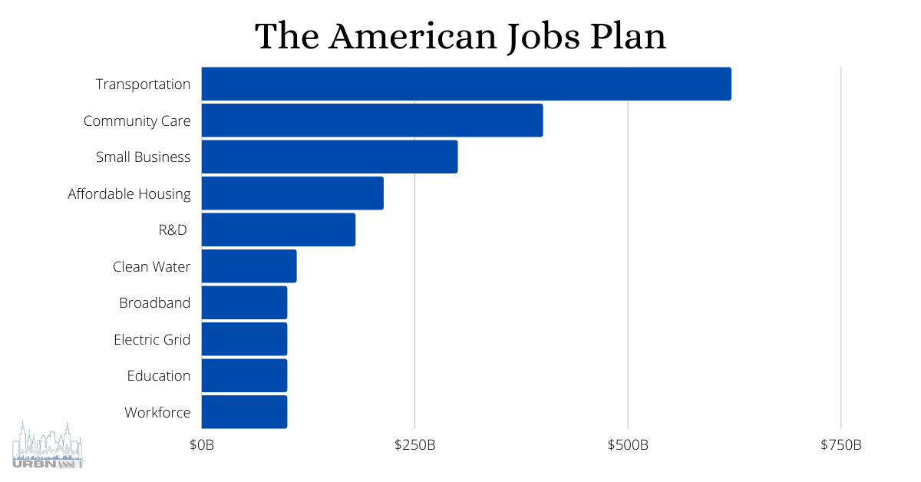
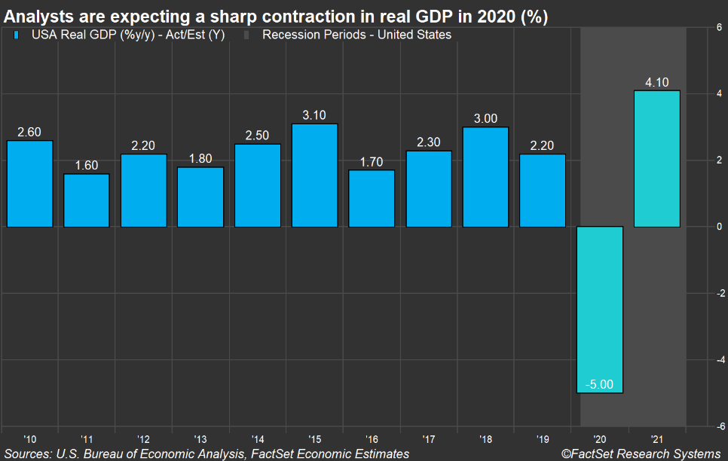
WAYFORWARD FOR
GHANA?

Slide 20
GHANA RESPONSE TO COVID-19 &
WAYFORWARD
SOURCE: MINISTRY OF FINANCE

Slide 22
 | FINANCING GHANA CARES GH S 100 BILLION FROM 2021 to 2023 |  | PERCENTAGE OF REVENUE TO GDP AS AT 2022 | REVENUE IMPROVEMENT RECOMMENDATIONS
A | GOVERNMENT | GH 30 BILLION, INCREASE TAX REVENUE FROM 13 TO 20 PERCENT OF GDP | 13 PERCENT | 1. PASS TAX EXEMPTION BILL ON FDI’S TO SAVE FUNDS IN SUPPORTING THE GHANA CARES PROGRAM
B | PRIVATE SECTOR | GH 70 BILLION, MAINLY FROM FDI AND PPP |  | 1. REVIEW GHANA INVESTMENT LAWS TO ENSURE FOREIGN INVESTORS RETAIN AND RE-INVEST A PERCENTAGE OF THEIR PROFIT. (GROWING SECTORS OF THE ECONOMY) 2. GOVERNMENT MUST INITIATE PROCESSES TO LIST STATE OWNED ENTERPRISES ON THE STOCK MARKET. TO ENSURE PRIVATE SECTOR PARTNERSHIP, EFFICIENCY AND PROFITABILITY.

Slide 23
CONCLUSION
XIE XIE
THANK YOU
Q&A

Slide 24
CONCLUSION
APPRECIATION
=========================================
OFFICE OF THE HEAD OF CIVIL SERVICE (OHCS)
MINISTRY OF TRANSPORT
MINISTRY OF COMMUNICATION AND DIGITILIZATION
MINISTRY OF COMMERCE IN CHINA
ECCO OFFICE OF THE CHINESE EMBASSY IN GHANA
UNIVERSITY OF INTERNATIONAL BUSINESS AND ECONOMICS(UIBE)

